Slide 1

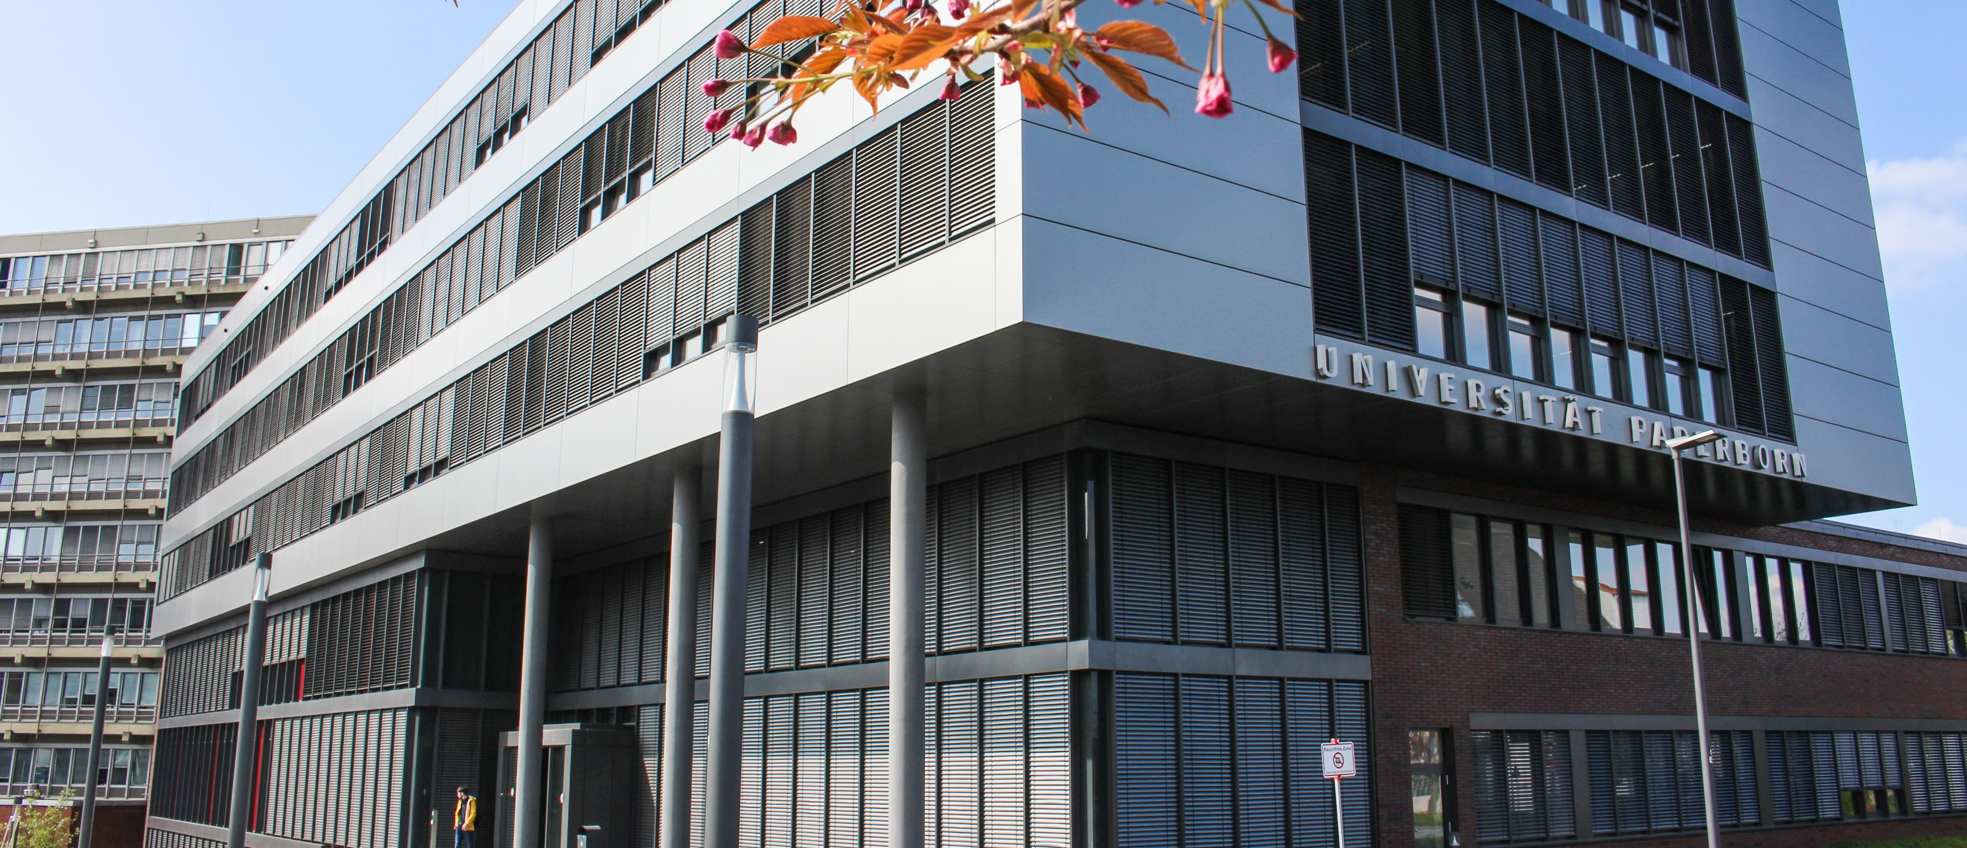
… in Profile

Slide 2
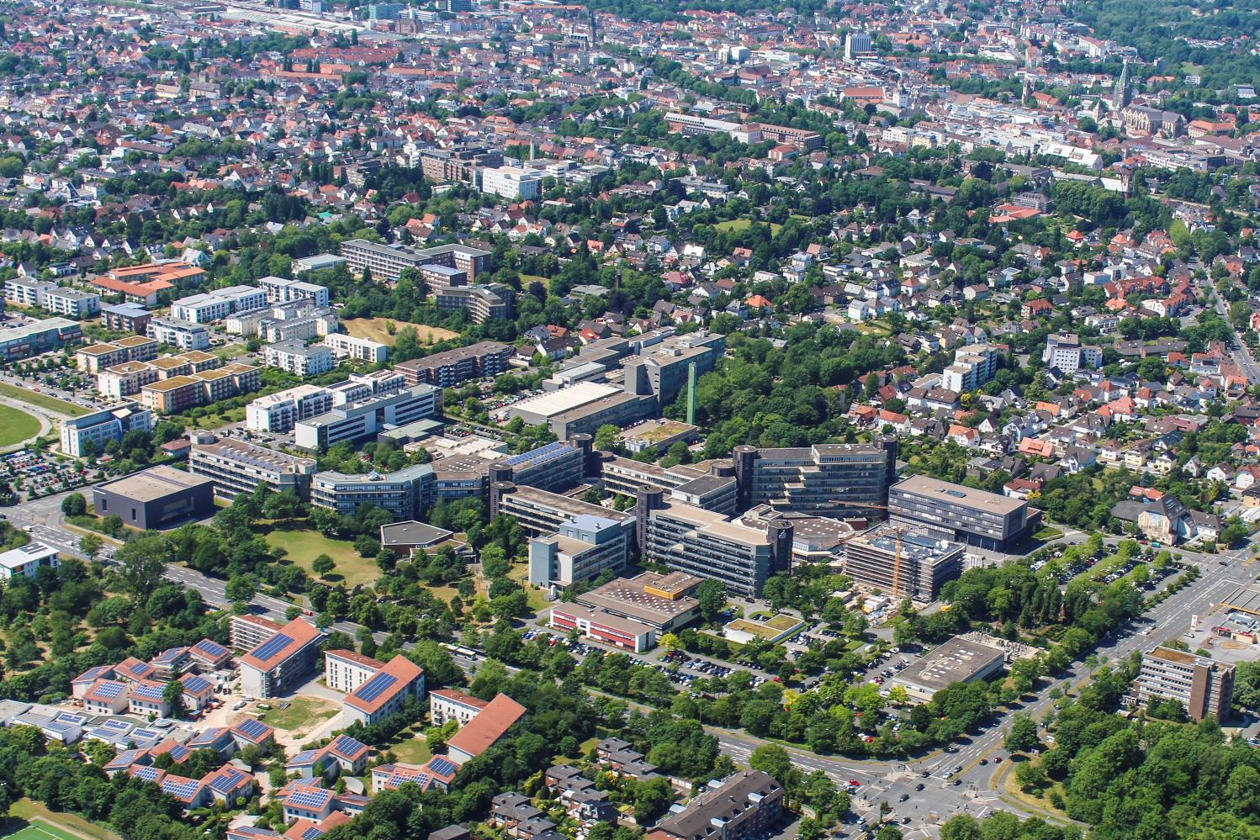

Slide 3
Brand – Profile – Mission Statement
The University for the Information Society
Paderborn University stands equally for state of the art education and innovative research
This profile
  creates the potential for networking information, communication, culture and technology
  generates an exemplary innovative force that will continue to be advanced in the future
  builds on computer science and its symbiotic potential as well as and equally on the complementary potential of the other fields of science and research working at Paderborn
  is characterized by interdisciplinary collaboration in all key areas
  means that the university conducts research for society and makes the results accessible for the economy through technology transfer
  reflects the unity of research and teaching

Slide 4
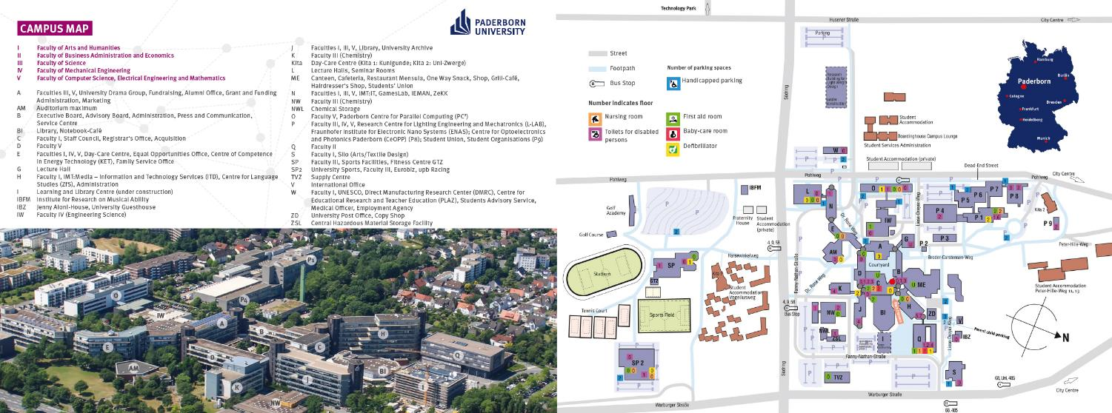
Campus

Slide 5
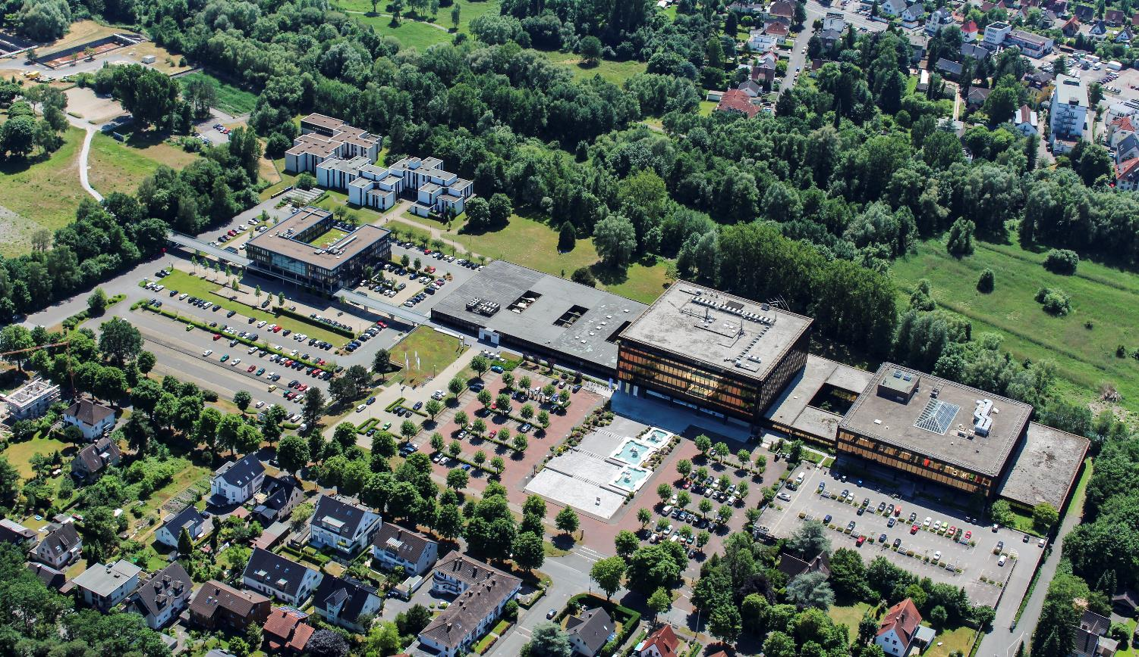
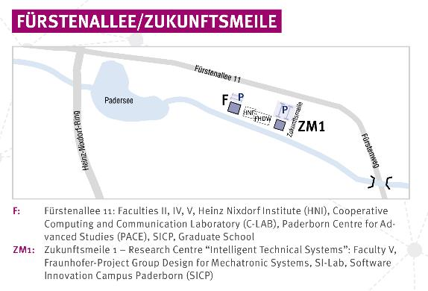
The University Site „Zukunftsmeile“ at Fürstenallee

Slide 6
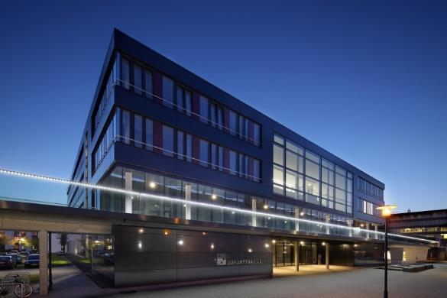
The „Zukunftsmeile“ Fürstenallee
Building 1 – Research Centre Intelligent Technical Systems
Workspace for 150 Academics
Research Groups:
Software Engineering (Prof. Dr. Eric Bodden)
Database and Information Systems (Prof. Dr. Gregor Engels)
Swarm Intelligence (Jun.-Prof. Dr. Heiko Hamann)
Software Quality Lab (s-lab)
Paderborn Institute for Advanced Studies (PACE)
Fraunhofer Research Institute for Design for Mechatronic Systems (IEM)
Software Innovation Campus Paderborn (SICP)
also
Networks InnoZent OWL e. V.
OWL Maschinenbau e. V.
it‘s OWL GmbH – Cluster Management
ViProSim e. V.
FHDW/bib International College

Slide 7
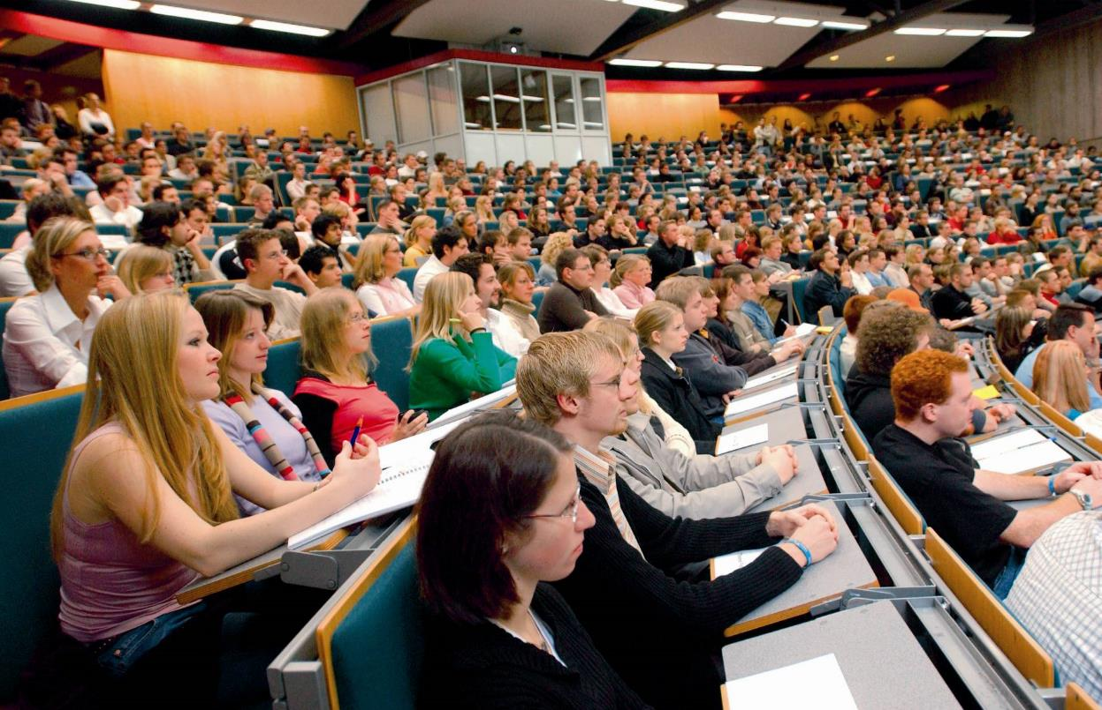
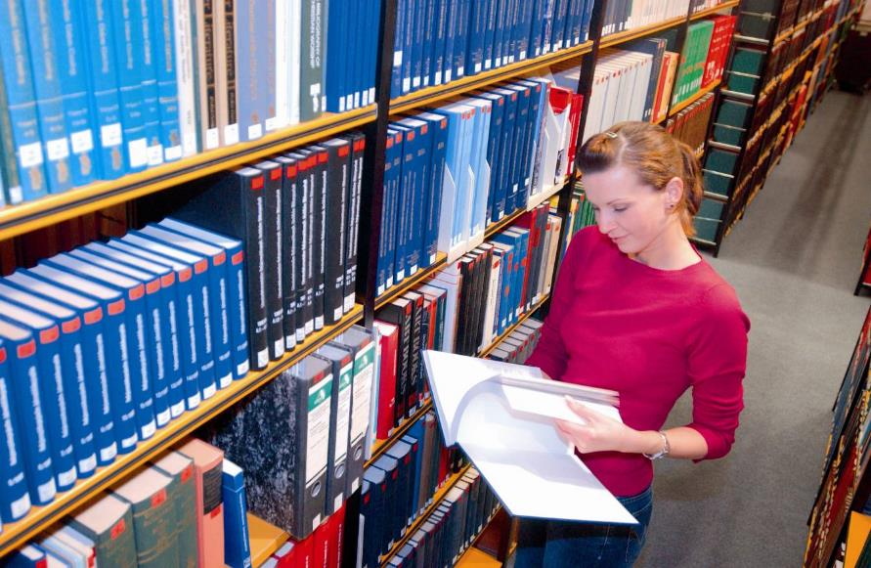
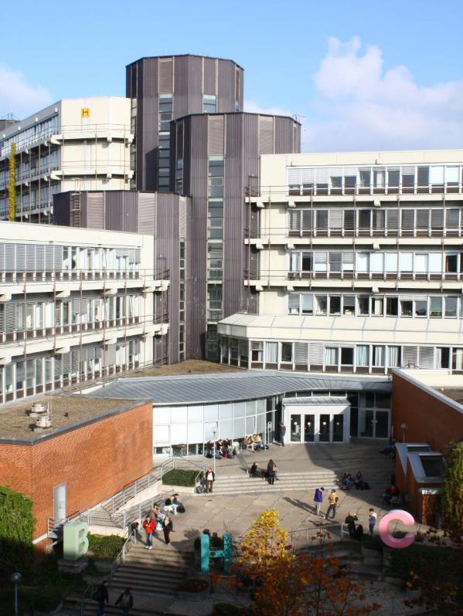
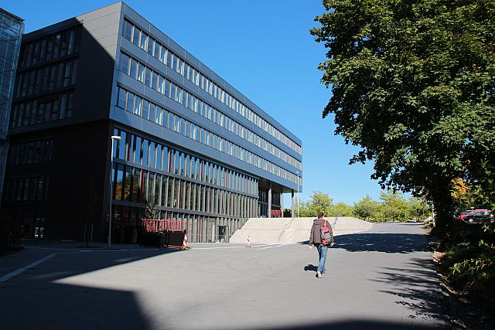
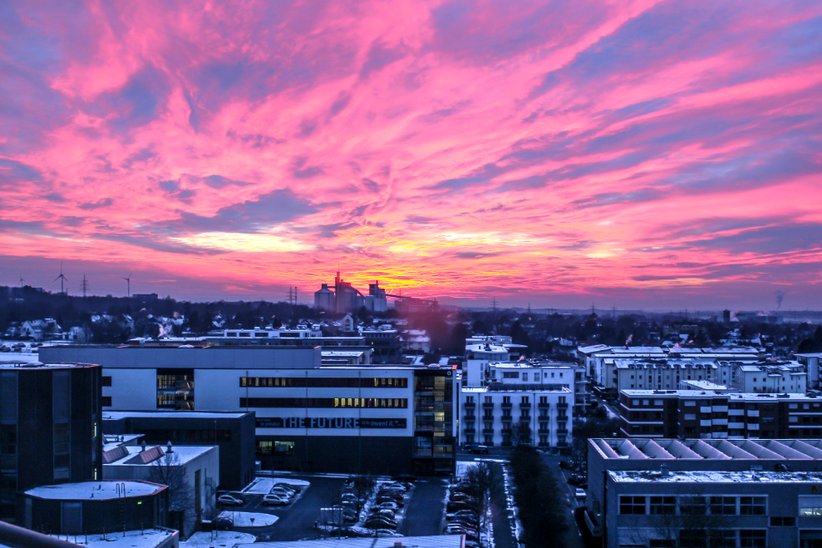
Impressions

Slide 8
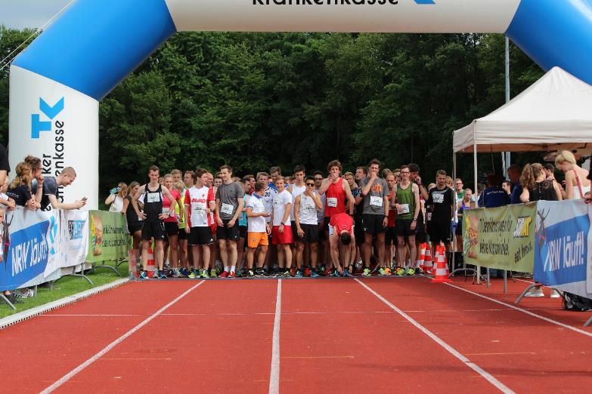
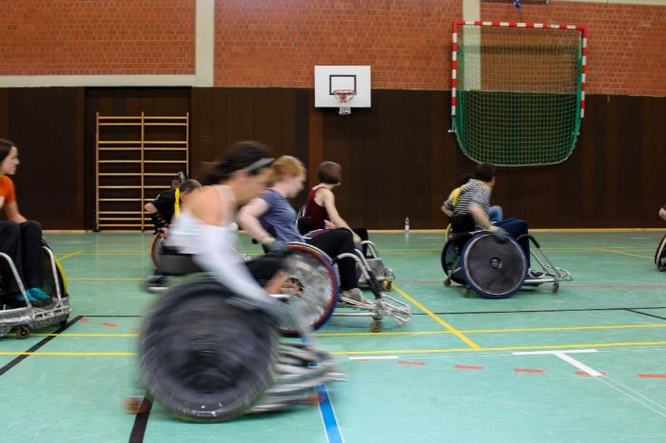
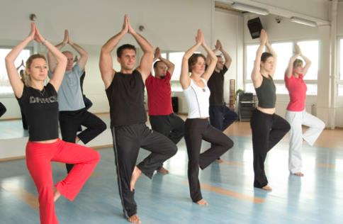
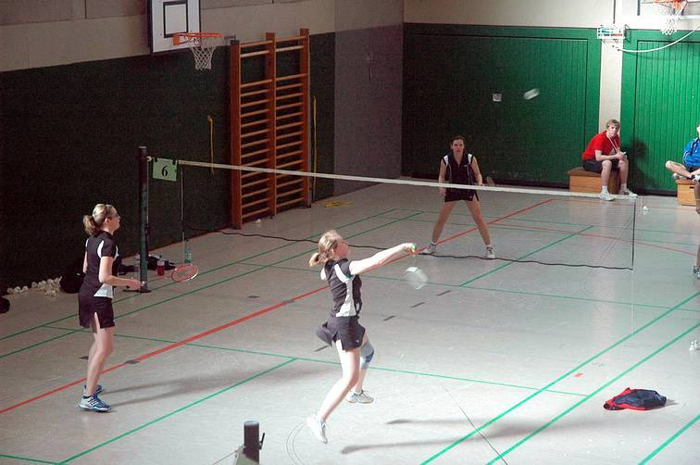
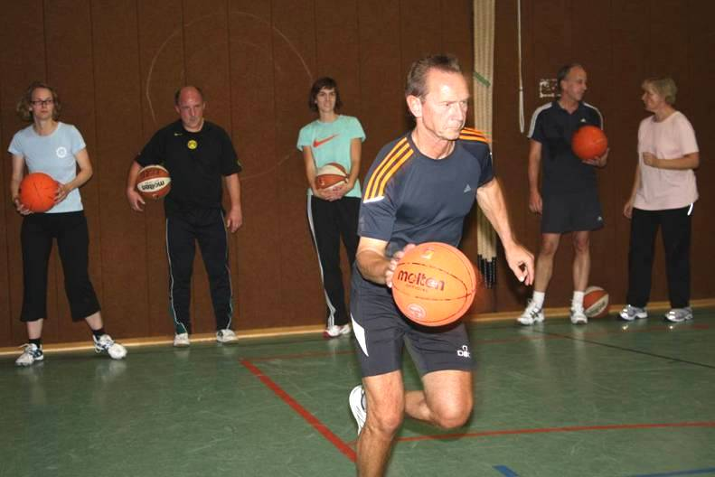
Studying and Sports

Slide 9
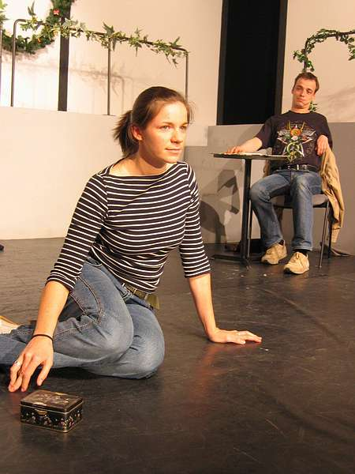
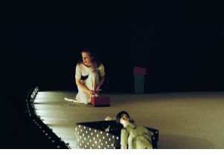
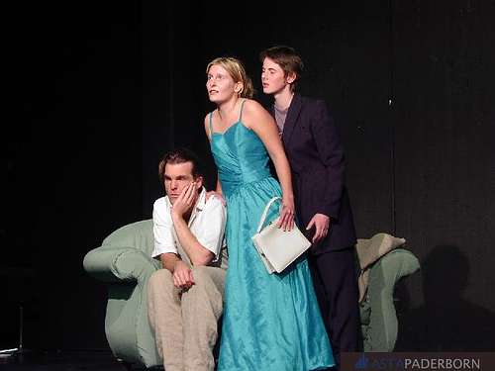
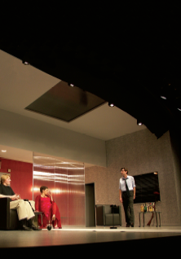
Studying and Culture

Slide 10
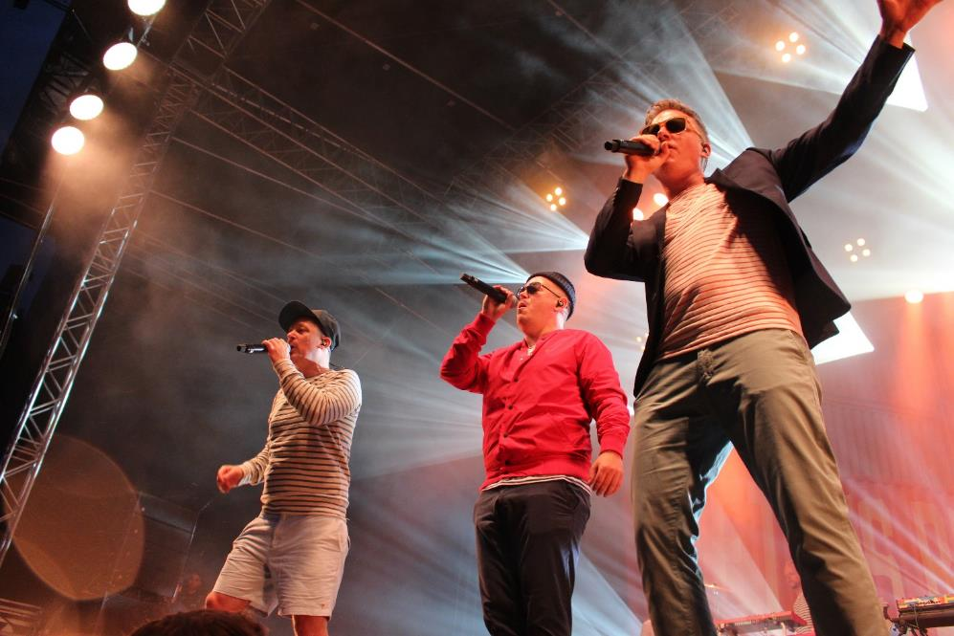
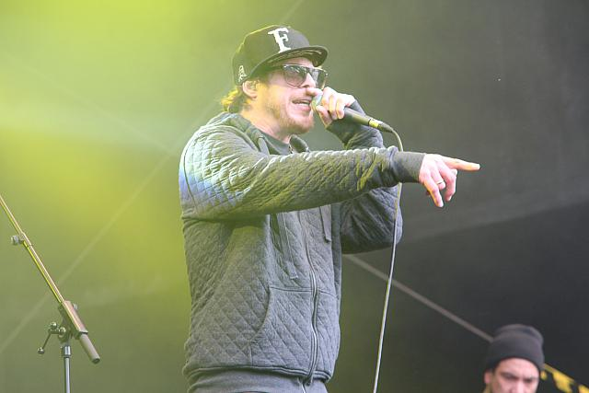
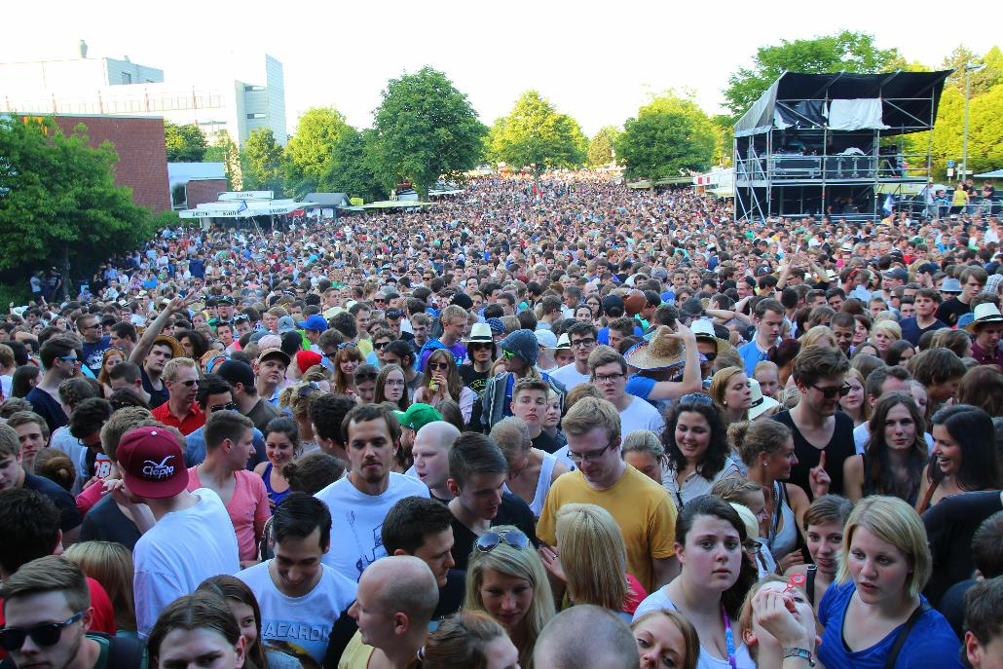
Summer-Festival

Slide 11
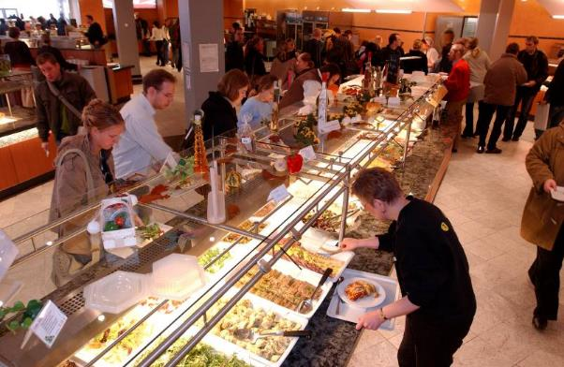
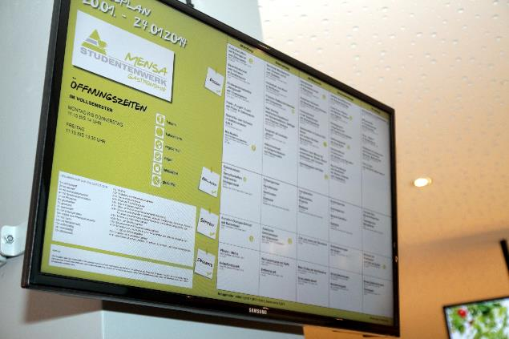
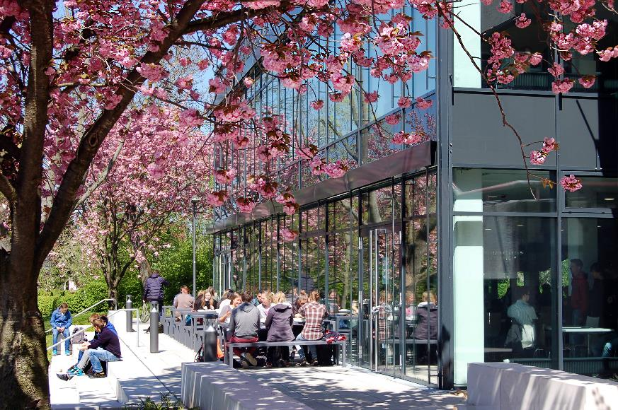
Mensa „Forum“ and „Academica“

Slide 12

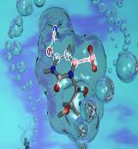
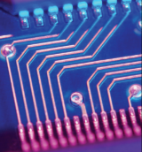
Paderborn Centre for Educational Research and Teaching Training (PLAZ)
Arts and Humanities
Business Administration and
Economics
Science
Mechanical
Engineering
Computer Science
Electrical Engineering
Mathematics
Paderborn Centre for Educational Research and Teaching Training

Slide 13
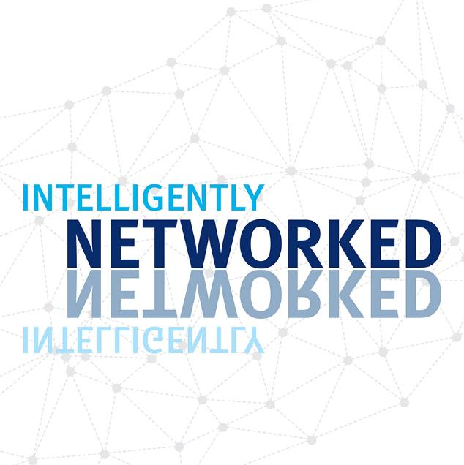
International Office
Partnerships with about 200 universities worldwide offer perfect opportunities for exchange programmes
8 Percent of the students come from abroad
Web: io.uni-paderborn.de

Slide 14
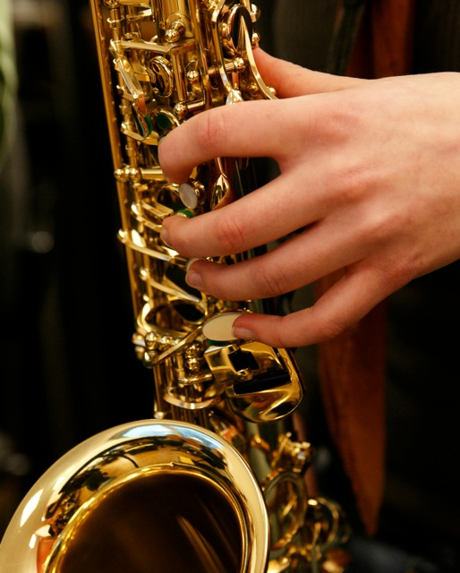

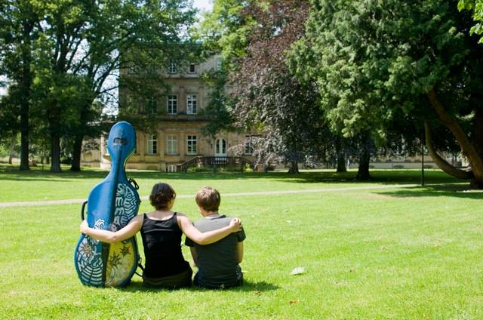
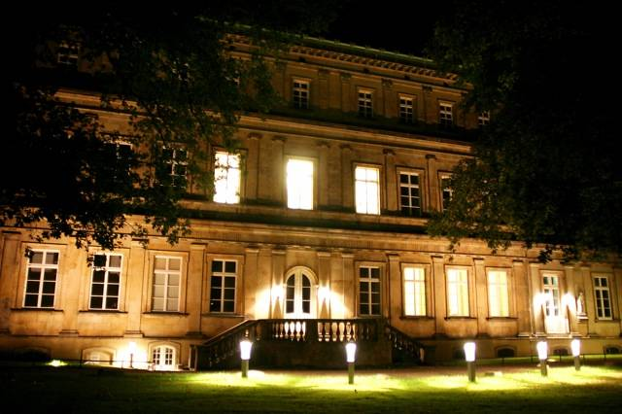
Hochschule für Musik Detmold
Hochschule für Musik Detmold

Slide 15
20,205 Students in Winter Semester 2017/18

Slide 16
Origin of Students
Total students | 20,205 | 100 %
Nordrhein-Westfalen (NRW) | 16,118 | 80 %
Ostwestfalen-Lippe | 9,713 | 48 %
Bielefeld | 1,076 | 5 %
Gütersloh | 1,080 | 5 %
Herford | 580 | 3 %
Höxter | 1,334 | 7 %
Lippe | 1,351 | 7 %
Minden-Lübbecke | 490 | 2 %
Paderborn | 3,802 | 19 %
Hochsauerlandkreis | 722 | 4 %
Soest | 1,639 | 8 %
Remaining NRW | 4,044 | 20 %
Other regions | 2,466 | 12 %
Foreign students | 1,621 | 8 %

Slide 17







Faculties at Paderborn University
I Faculty of Arts and Humanities
II Faculty of Business Administration and Economics
III Faculty of Science
IV Faculty of Mechanical Engineering
V Faculty of Computer Science, Electrical Engineering and Mathematics

Slide 18
Faculty of Arts and Humanities
Department of English and American Studies
Department of Education
Department of Protestant Theology
Department of German Studies and Comparative Literary Studies
Department of History
Department of Social and Human Sciences
Department of Catholic Theology
Department of Art / Music / Textiles
Department of Media Studies
Department of Romance Languages
Musicology Seminar Detmold/Paderborn

Slide 19

Faculty of Business Administration and Economics
Department 1 Management
Department 2 Taxation, Accounting and Finance
Department 3 Business Information Systems
Department 4 Economics
Department 5 Business and Human Resource Education
Department 6 Law

Slide 20

Faculty of Science
Department of Chemistry
Department of Physics
Department of Exercise and Health

Slide 21
Faculty of Mechanical Engineering
Sixteen professorships
Five interdisciplinary and cross-faculty research facilities:
  Competence Centre for Sustainable Energy Technology (KET)
  Direct Manufacturing Research Center (DMRC)
  Fraunhofer Research Institute for Design of Mechatronic Systems (IEM)
  Heinz Nixdorf Institute (HNI)
  Institute for Lightweight Design with Hybrid Systems (ILH)

Slide 22

Faculty of Mechanical, Computer Science and
Electrical Engineering and Mathematics
Department of Electrical Engineering and Information Technology
Department of Computer Science
Department of Mathematics

Slide 23
The University 2018 in Numbers
  Staff: 2,425
    260 Professors
    124 Academics staff with civil servant status
    42 Research assistants
    1,254 Other academic staff
    696 Non-academic staff
    49 Trainees/Apprentices
  20,205 students in winter semester 2017/2018
  Externally-funded expenditures: 50.4 million euros in 2017
  (including other external funds, such as NRW research funding or funding for
  large-scale facilities by the DFG)

Slide 24
Expenditure of External Funds in 1,000 Euros

Slide 25
Key Research Areas
Digital Humanities
Intelligent Technical Systems
Lightweight Design with Hybrid Systems
Optoelectronics and Photonics

Slide 26
Central Research Facilities
Centre of Excellence “Music-Edition-Media” (Paderborn University, University of Music Detmold, Ostwestfalen-Lippe University of Applied Sciences)
Center for Comparative Theology and Cultural Studies (ZeKK)
Center for Gender Studies (ZG)
Centre for Optoelectronics and Photonics Paderborn (CeOPP)
Competence Centre for Sustainable Energy Technology (KET)
Heinz Nixdorf Institute (HNI)
Institute for Lightweight Design with Hybrid Systems (ILH)
Musicology Seminar Detmold/Paderborn
Paderborn Teacher Training Centre (PLAZ)
Paderborn Centre for Parallel Computing (PC²)
Paderborn Institute for Advanced Studies in Computer Science and Engineering (PACE)
Paderborn Institute for Scientific Computation (PaSCo)
Software Innovation Lab (SI-Lab)

Slide 27
DFG-funded Research Centres
Collaborative Research Centres
  SFB 901 – On-the-Fly Computing
  SFB/TRR 142 – Tailored Nonlinear Photonics: From Fundamental Concepts to Functional Structures
DFG-Research Units
  Acoustic Sensor Networks
  Dynamics of Electron Transfer Processes at Transition Metal Centres in Biological and Bioinorganic Systems

Slide 28
Graduate Schools
Energy- and Cost-Efficient Extreme Lightweight Design with Hybrid Materials
Design of Flexible Work Environments – Human-Centric Use of Cyber-Physical Systems in Industry 4.0
Individual Support: Competence Development in Vocational Education
International Graduate School of Intelligent Systems in Automation Technology (ISA)
Islamic Theology

Slide 29
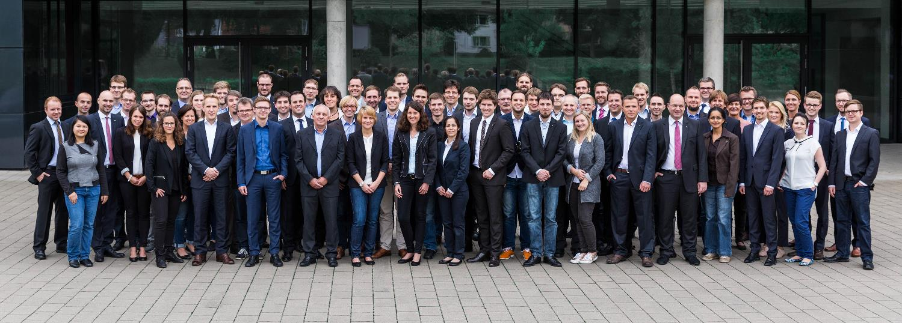
Fraunhofer Institutions
Fraunhofer Research Institute for Mechatronic Systems Design (IEM)
Fraunhofer ENAS, Department of Advanced Sytems Engineering (ASE)

Slide 30
Technology and Knowledge Transfer
C-LAB – Cooperative Computing & Communication Laboratory – The Innovations Workshop for Atos and the Paderborn University
Direct Manufacturing Research Center (DMRC) – Consortium industry partners and Paderborn University
It’s owl - BMBF- Leading-Edge Cluster „Intelligent Technical Systems OstWestfalenLippe“
L-LAB – Research Centre for Lighting Engineering and Mechatronics. Public Private Partnership between Hella KG Hueck & Co., Hamm-Lippstadt University of Applied Sciences and Paderborn University
Software Innovation Campus Paderborn (SICP) – Research Campus of 10 partner companies and the Fraunhofer-Project Group Design of Mechatronic Systems

Slide 31

University Spin-offs at the Technology Park
ActiDoo GmbH Appentwicklung
ATHENA Technologie Beratung GmbH Technologieberatung
aXon Gesellschaft für Informationssysteme mbH Internet-Anwendungen
BEDEM Personaldienstleister
Campus Consult e.V. Beratung
Campus Consult Projektmanagement GmbH Projektmanagement
energy4ever GmbH Solartechnik
ESL EnergieSpeicherLösungen GmbH Dienstleister für Elektromobilität
FASTEC GmbH Materialflussautomation & Produktionsmanagement Steuerungstechnik
GAUSS-LVS GmbH Software
Heege Software GbR Digitale Bildverarbeitung
HSM IT-Services GmbH Oracle Consulting, Apex Entwicklung und Schnittstellendesign
iMPLI Informations-Systeme GmbH Internetservice
Incony AG Internetanwendungen
InnovaKom GmbH Produktdaten- und Bildverwaltung
ITEK GmbH Service Forschung, Beratung, Entwicklung & Schulung
KT IT Solutions Oswald & Christ GbR IT-Dienstleister
LEONEX Internet GmbH IT-Dienstleister
maxcluster GmbH Hosting-Lösungen
mechOnics AG Linearantriebe Mikro- bzw. Nanopositionierung
MeineLinse GmbH e-Commerce, Versandhandel

Slide 32
University Spin-offs at the Technology Park
MKV Consult Marketing
neam IT-Services GmbH Kommunikationslösungen
nextTalents GmbH Personaldienstleister u. Projektsupport
OctoGate IT Security Systems GmbH IT-Sicherheit
onmado UG Online Marketing Agentur
ORconomy GmbH Prozessberatung
progresso group GbR Unternehmensberatung, Prozessoptimierung
Raynet GmbH IT-Dienstleister
Schael Internet-Dienstleistungen Internet-Dienstleistungen
SICUS GmbH ITK-Services
StudyHelp GmbH Nachhilfe-Dienstleister
SWS SoftWare-Systeme GmbH Softwarelösungen
System Integration Laboratory GmbH Systemintegrationslösungen
Tarvenkorn & Wickord Patentanwälte Partnerschaftsgesellschaft mbB Patentanwälte
Teamnet GmbH Software-Entwicklung
veedapp / Otutuama, Cannon, Martins Pereira GbR Appentwicklung
vermitu GmbH Vergleichsportal für Medienartikel
W-AYS GmbH & Co. KG Full-Service-Partner für IT u. Organisation
wabsolute GmbH Web-Lösungen
ÖZEL Agentur für Design und Marketing GmbH Design und Marketing

Slide 33
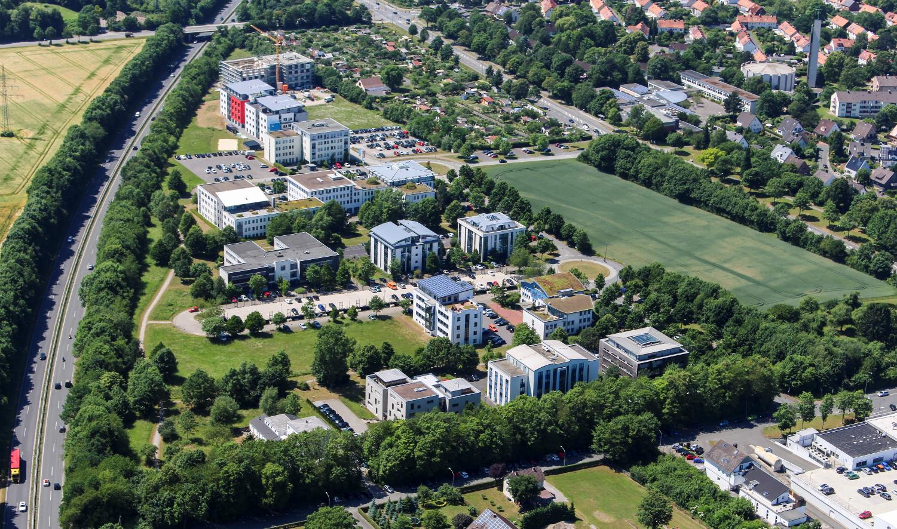
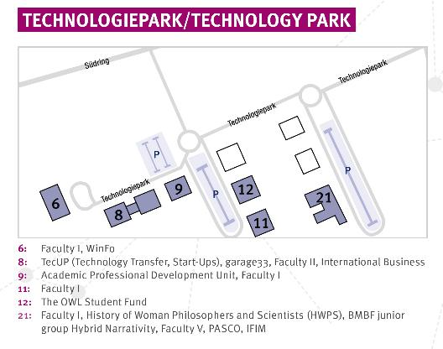
Technology Park

Slide 34
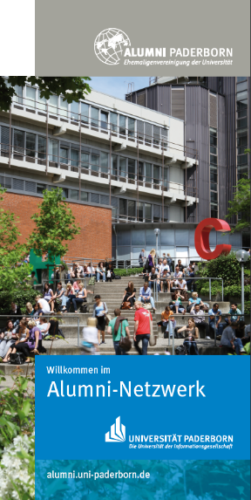
The University‘s Alumni-Networks
22 Alumni Clubs with more than 2,700 members
Former students, professors and staff from the various faculties
What the alumni work aims to achieve:
Lifelong ties with the university
Lively network of mutual and reciprocal support
Contacts and information exchange all about the university
Services and offerings provided by the alumni clubs
Network meetings and information
Financial and moral support for university projects and events
Funding for students via grants, scholarships or fellowships
Offers all about student and career development opportunities
www.uni-paderborn.de/alumni

Slide 35

Studienfonds OWL Foundation
Donations amounting to nearly 4 million euros
Role model for the National Scholarship Programme
(Deutschlandstipendium)
More than 230 companies, foundations, institutions and
private sponsors in the Friends of the University (Förderkreis)
Scholarship holders in the network of
Sponsors
Comprehensive support programme for scholarship holders
thanks to the close collaboration with sponsor companies and institutions
Foundation established in 2009
Applications for the winter semester 2018/19 can be submitted as from March 2018 at: www.studienfonds-owl.de

Slide 36

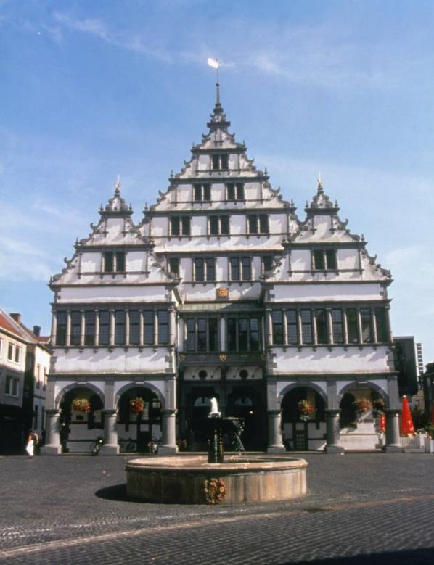
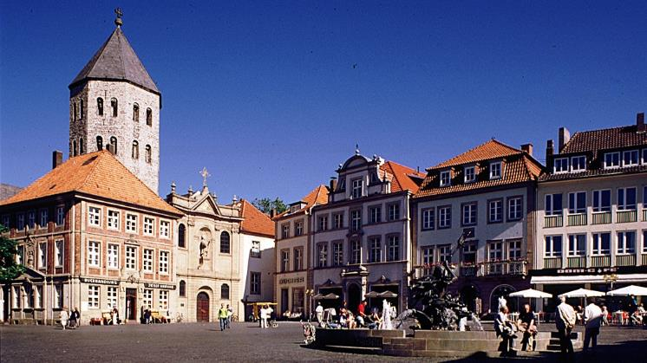
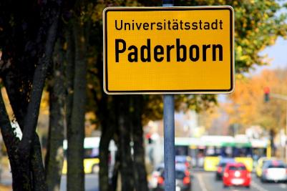
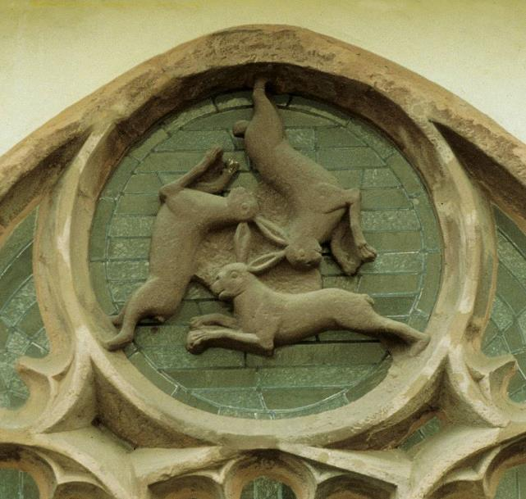
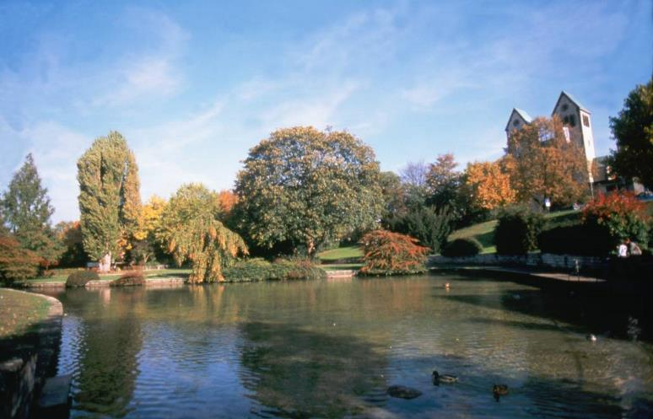
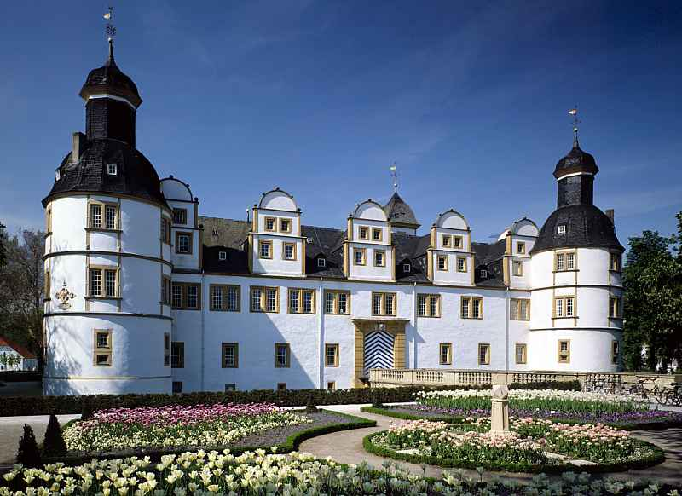
University Town of Paderborn

