Slide 1
Statistics and Facts
Paderborn University
In Profile

Slide 2
TABLE OF CONTENTS
Paderborn university
In Profile
Aerial picture, Campus Map of the University and Profile
The University in numbers
Faculties at Paderborn University
Research
Transfer/Founding
Paderborn as a business location
University town Paderborn
Networks
Impressions of the campus
Imprint

Slide 3
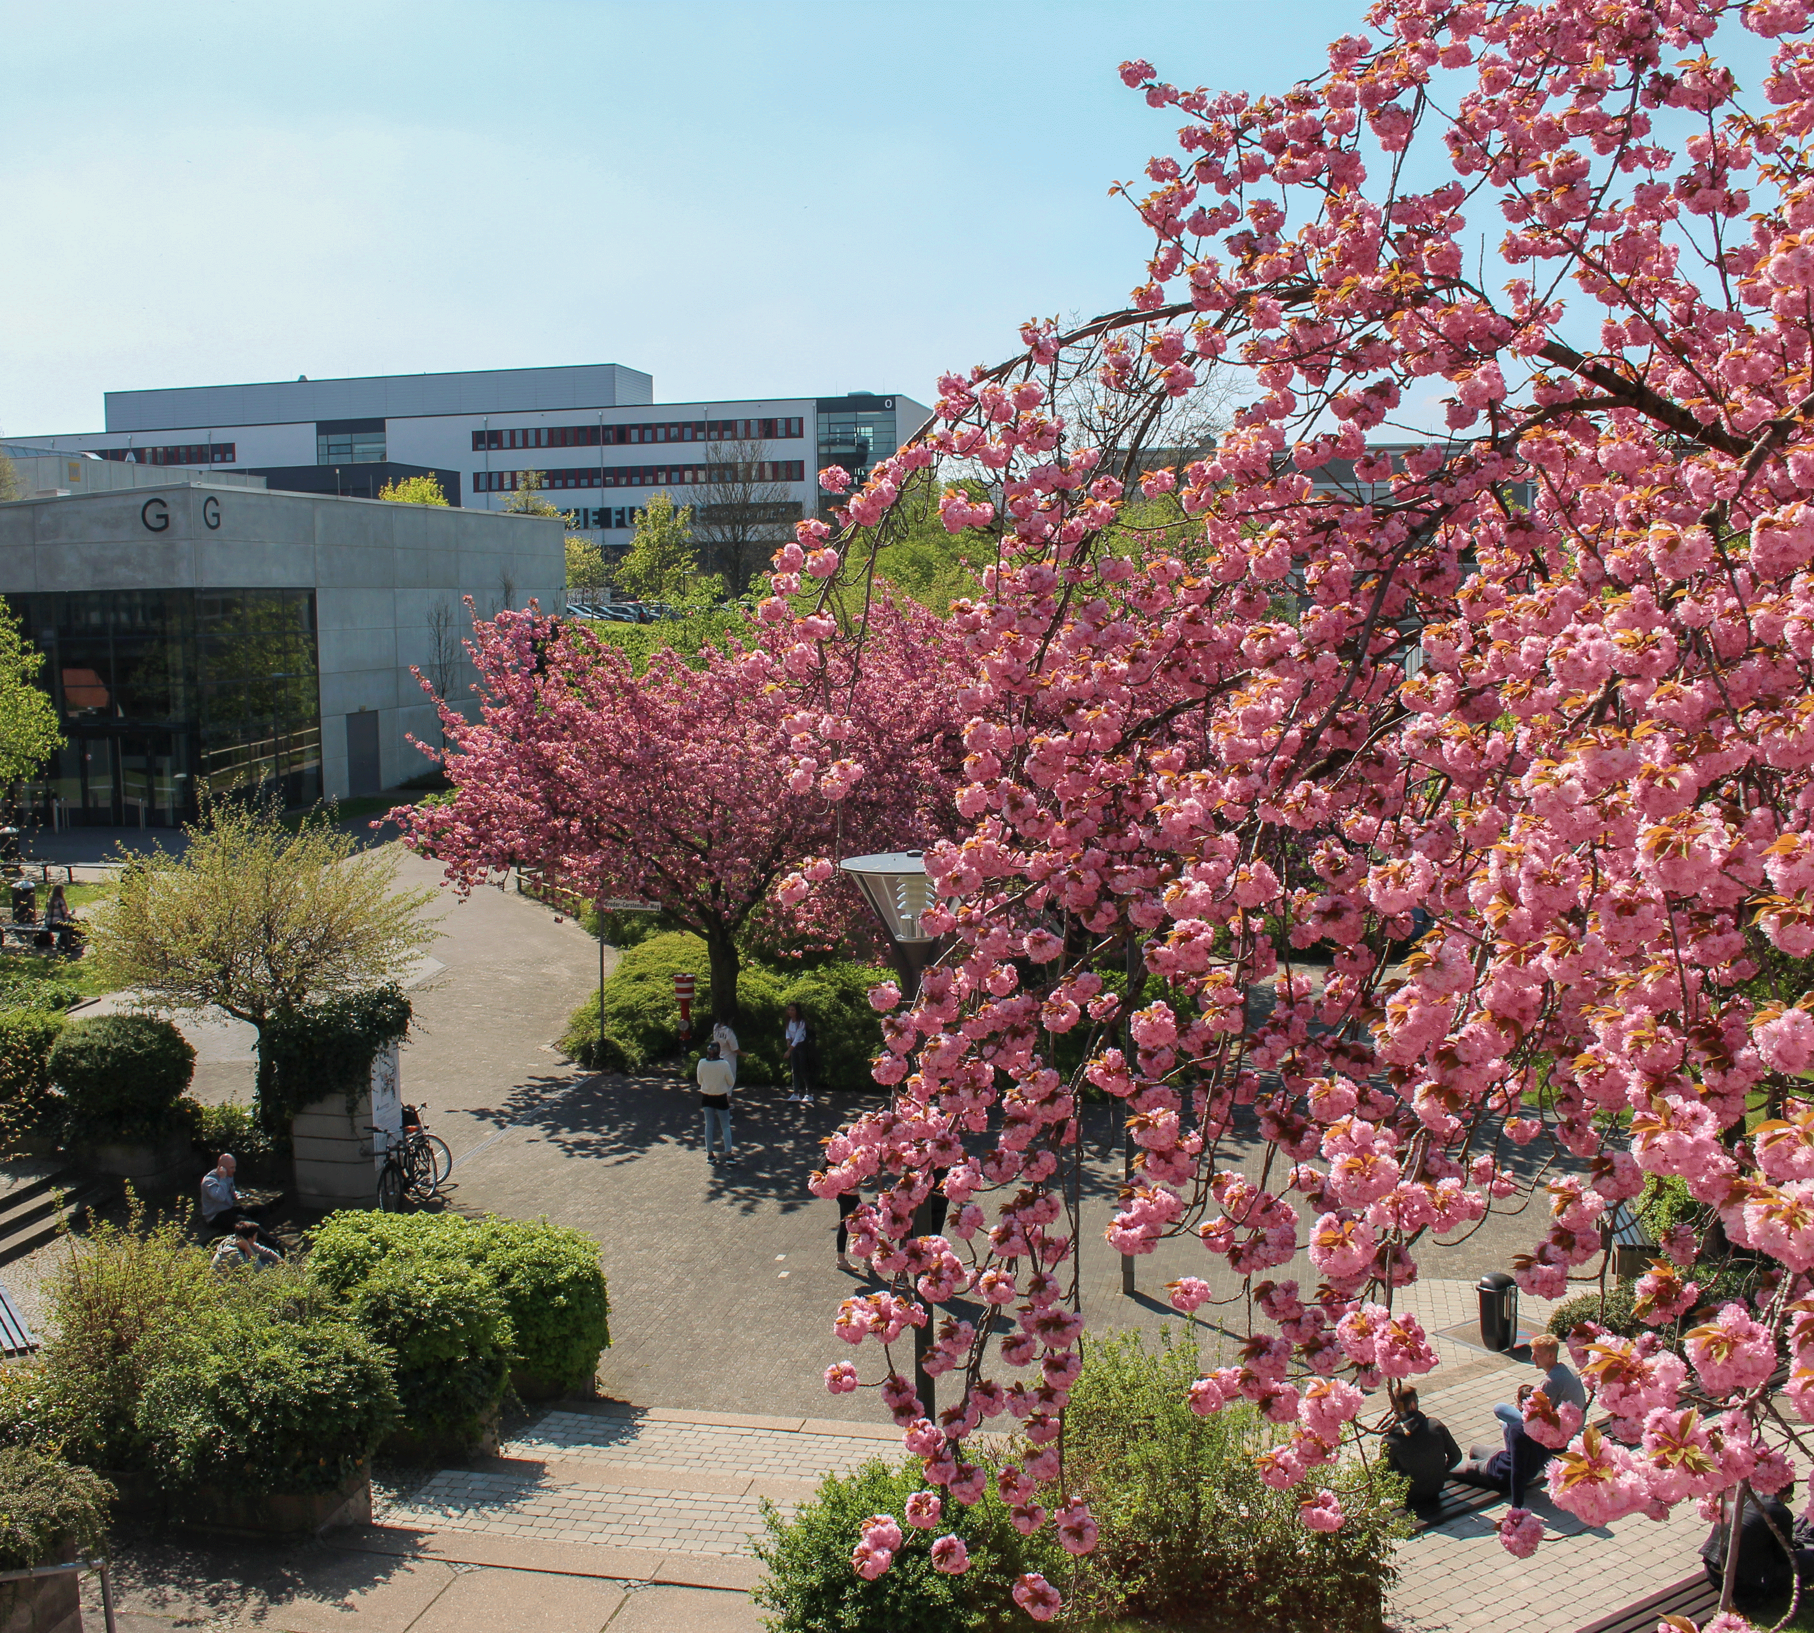
Aerial picture, Campus Map
and Profile

Slide 4
PADERBORN UNIVERSITY*
Paderborn University
In Profile
* Picture taken in July 2019

Slide 5
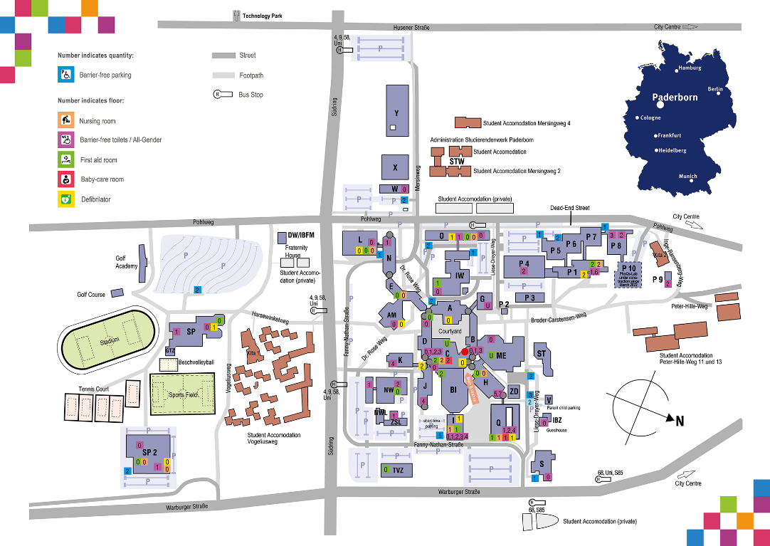
CAMPUS MAP
Paderborn University
In ProfilE

Slide 6
PROFILE
Paderborn University
In Profile
The University for the Information Society – Paderborn University stands equally for state of the art education and innovative research. This profile…
creates the potential for networking information, communication, culture and technology
generates an exemplary innovative force that will continue to be advanced in the future
builds on computer science and its symbiotic potential as well as and equally on the complementary potential of the other fields of science and research working at Paderborn
is characterized by interdisciplinary collaboration in all key areas
means that the university conducts research for society and makes the results accessible for the economy through technology transfer
reflects the unity of research and teaching

Slide 7
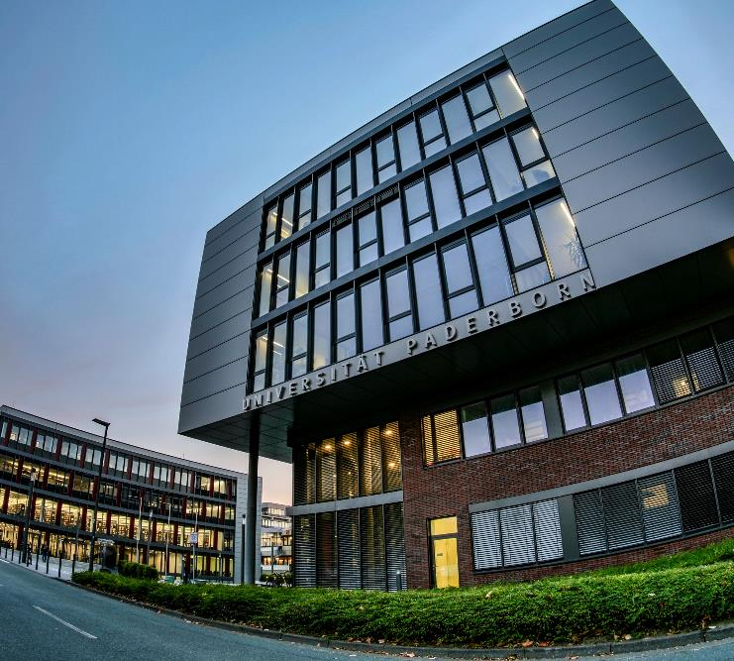
The University
In numbers

Slide 8
STUDENTS
Paderborn University
In Profile
19,076 Students in Wintersemester 2021/22

Slide 9
STUDENTS
Paderborn University
In Profile
Origin of Students:
Total | 19,076 | 100 %
Federal state of North Rhine-Westphalia | 14,586 | 77 %
Other German federal states | 2,174 | 11 %
Foreign countries | 2,316 | 12 %
Continent | Students | Percent
Africa | 390 | 17 %
America | 46 | 2 %
Asia | 1,355 | 58 %
Australia | 1 | 0 %
Europe | 524 | 23 %
Total | 2,316 | 100 %

Slide 10
STAFF
Paderborn University
In Profile
Staff: 2,646*
* In January 2022

Slide 11
FINANCES
Paderborn university
In profile
Externally-funded expenditures: 63,8 million euros* in 2021
(including other external funds, such as NRW research funding or funding for large-scale facilities by the DFG)
* Expenditure of External Funds in 1,000 €

Slide 12
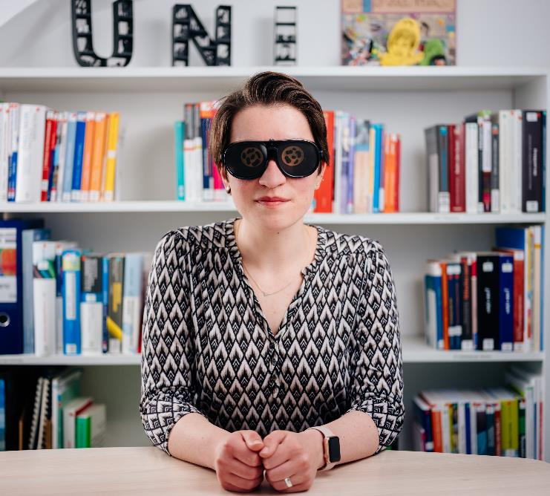
Faculties at
Paderborn University

Slide 13
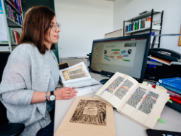
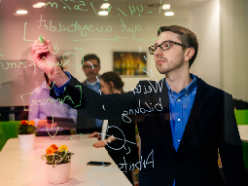
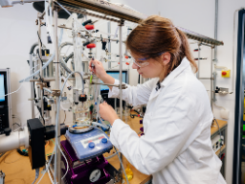
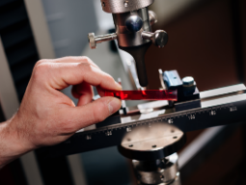
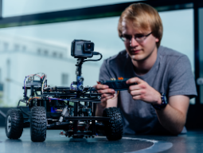
FACULTIES AT PADERBORN UNIVERSITY
Paderborn university
In Profile
KW: Faculty of Arts and Humanities
WW: Faculty of Business Administration and Economics
NW: Faculty of Science
MB: Faculty of Mechanical Engineering
EIM: Faculty of Computer Science, Electrical Engineering and Mathematics

Slide 14
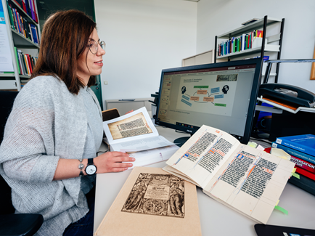
FACULTY OF ARTS AND HUMANITIES
Paderborn University
In Profile
Department of English and American Studies
Department of Education
Department of Protestant Theology
Department of German Studies and
Comparative Literary Studies
Department of History
Department of Social and Human Sciences
(Philosophy, Psychology, Sociology)
Department of Catholic Theology
Department of Art / Music / Textiles
Department of Media Studies
Department of Romance Languages
Musicology Seminar Detmold / Paderborn
Department of Islamic Theology

Slide 15
FACULTY OF BUSINESS ADMINISTRATION AND ECONOMICS
Paderborn University
In Profile
Department 1 Management
Department 2 Taxation, Accounting and Finance
Department 3 Business Information Systems
Department 4 Economics
Department 5 Business and Human Resource Education
Department 6 Law

Slide 16
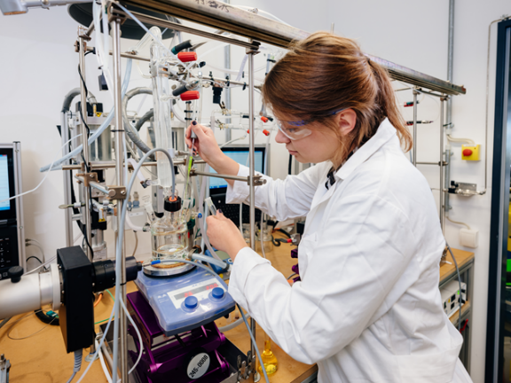
FACULTY OF SCIENCE
Paderborn University
In Profile
Department of Chemistry
Department of Physics
Department of Exercise and Health

Slide 17
FACULTY OF MECHANICAL ENGINEERING
Paderborn University
In Profile
Seventeen professorships
Six interdisciplinary and cross-faculty research facilities:
Competence Centre for Sustainable Energy Technology (KET)
Direct Manufacturing Research Center (DMRC)
Fraunhofer Research Institute for Design of Mechatronic Systems (IEM)
Heinz Nixdorf Institute (HNI)
Institute for Lightweight Design with Hybrid Systems (ILH)
Paderborn Institute for Additive Fabrication (PIAF)

Slide 18
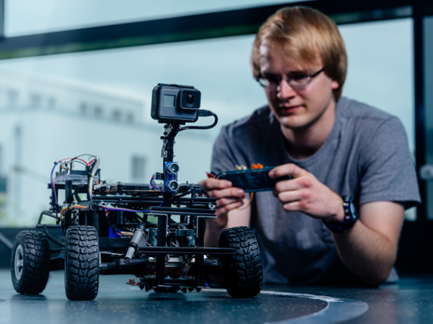
FACULTY OF COMPUTER SCIENCE, ELECTRICAL ENGINEERING AND MATHEMATICS
Paderborn University
In Profile
Department of Electrical Engineering and Information Technology
Department of Computer Science
Department of Mathematics

Slide 19
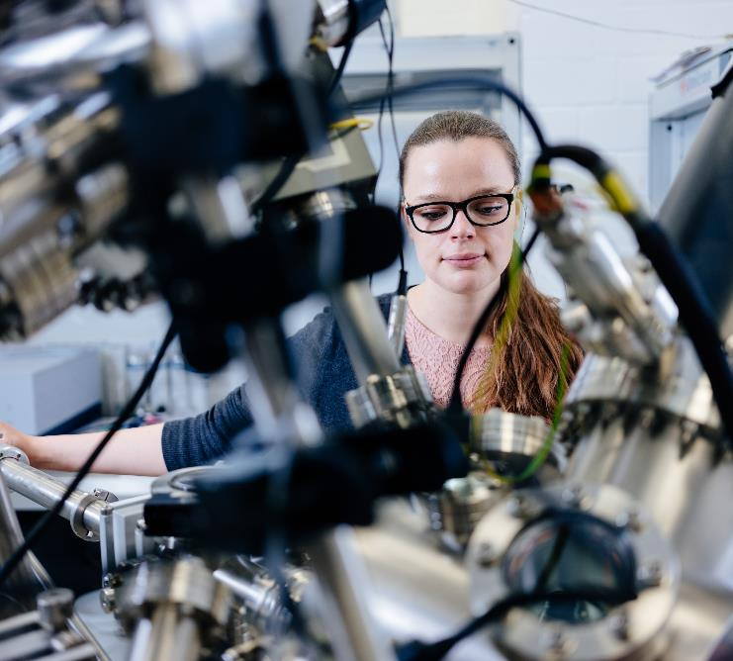
Research

Slide 20
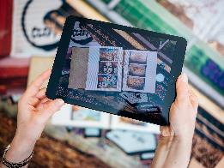
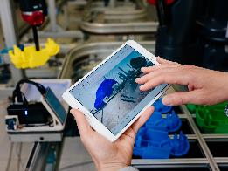
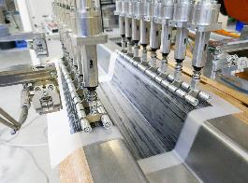
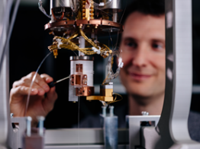
KEY RESEARCH AREAS
Paderborn university
In Profile
Digital Humanities
Intelligent Technical Systems
Sustainable materials, processes and products
Optoelectronics and Photonics
Transformation and Education

Slide 21
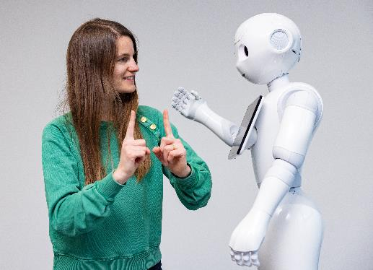
DFG* COLLABORATIVE RESEARCH CENTRES
Paderborn University
In Profile
Accounting for Transparency (TRR 266)
Constructing Explainability (TRR 318)
Tailored Nonlinear Photonics: From Fundamental Concepts to Functional Structures (TRR 142)
Method development for mechanical joinability in versatile process chains (TRR 285)
On-The-Fly Computing (SFB 901)
* DFG = German Research Foundation

Slide 22
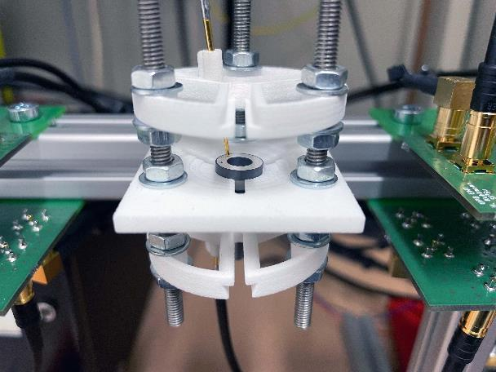
DFG* RESEARCH UNIT
Paderborn University
In Profile
Acoustic sensor networks
Model-based determination of non-linear properties of piezoceramics for power transducer applications
* DFG = German Research Foundation

Slide 23
INTERDISCIPLINARY RESEARCH FACILITIES
Paderborn University
In Profile
Centre for Comparative Theology and Cultural Studies (ZeKK)
Centre for Gender Studies (ZG)
Centre for Optoelectronics and Photonics Paderborn (CeOPP)
Centre of Excellence “Music – Edition – Media”, Paderborn University, University of Music Detmold and Ostwestfalen-Lippe University of Applied Sciences and Arts (ZenMEM)
Competence Centre for Sustainable Energy Technology (KET)
Heinz Nixdorf Institute (HNI)
Institute for Lightweight Design with Hybrid Systems (ILH)
Institute for Photonic Quantum Systems (PhoQS)
Musicology Seminar Detmold/Paderborn
Paderborn Centre for Advanced Studies (PACE)
Paderborn Centre for Educational Research and Teacher Training (PLAZ-Professional School)
Paderborn Centre for Parallel Computing (PC² / national high-performance computing center)
Paderborn Institute for Additive Fabrication (PIAF)
Paderborn Institute for Data Science and Scientific Computing (DaSCo)
Software Innovation Lab (SI-Lab)

Slide 24
PADERBORN CENTRE FOR EDUCATIONAL RESEARCH AND TEACHER TRAINING (PLAZ-PROFESSIONAL SCHOOL)
Paderborn university
In Profile
Faculty of
ARTS AND HUMANITIES
Faculty of
BUSINESS ADMINISTRATION AND ECONOMICS
Faculty of
SCIENCE
Faculty of
MECHANICAL ENGINEERING
Faculty of
COMPUTER SCIENCE, ELECTRICAL ENGINEERING AND MATHEMATICS
Paderborn Centre for Educational Research
and Teacher Training

Slide 25
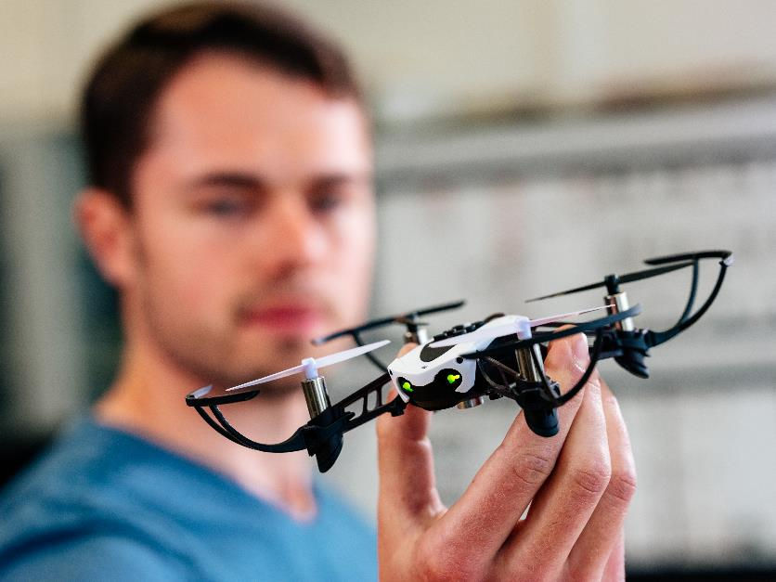
NETWORKED SUPPORT FOR EARLY-CAREER RESEARCHERS
Paderborn university
In Profile
Jenny Aloni Center for Early-Career Researchers

Slide 26
PROMOTION OF JUNIOR ACADEMICS
Paderborn university
In Profile
Emmy-Noether-Programme of the German Research Foundation
2019: Emmy Noether Independent Junior Research Group “Microlocal Methods for Hyperbolic Dynamics”
2019: Emmy Noether Independent Junior Research Group “Foundations of encrypted optimization- based control for networked systems”
Heisenberg-Programme of the German Research Foundation
2021: Heisenberg professorship “Modern and Contemporary History”
2015: Heisenberg professorship “Theory of functional photonic structures”

Slide 27
PROMOTION OF JUNIOR ACADEMICS
Paderborn university
In Profile
Funding of Junior Research Groups by the Federal Ministry of Education and Research
2022: Junior Research Group “Innovation and transfer processes in vocational training”
2020: Junior Research Group “Data-driven methods in control engineering”
2015: Junior Research Group “Hybrid Narrativity: Digital and Cognitive Approaches to Graphic Literature”
Funding of research groups by the Hans Böckler Foundation
2019: Research Group “Social inequality and right-wing populist attitudes. Does the
social divide threaten democracy?”

Slide 28
GRADUATE SCHOOLS
Paderborn University
In Profile
Being the Church in a Time of Change
Design of Flexible Work Environments – Human-Centred Use of Cyber-Physical Systems in Industry 4.0
KnowGraphs – Knowledge Graphs at Scale
“Light – Efficient – Mobile” Energy- and Cost-Efficient Extreme Lightweight Design with Hybrid Materials
Max Planck School of Photonics
Trustworthy AI for Seamless Problem Solving: Next Generation Intelligence Joins Robust Data Analysis (Data NInJA)
Research Training Group on Human Centered Systems Security (nerd.nrw)

Slide 29
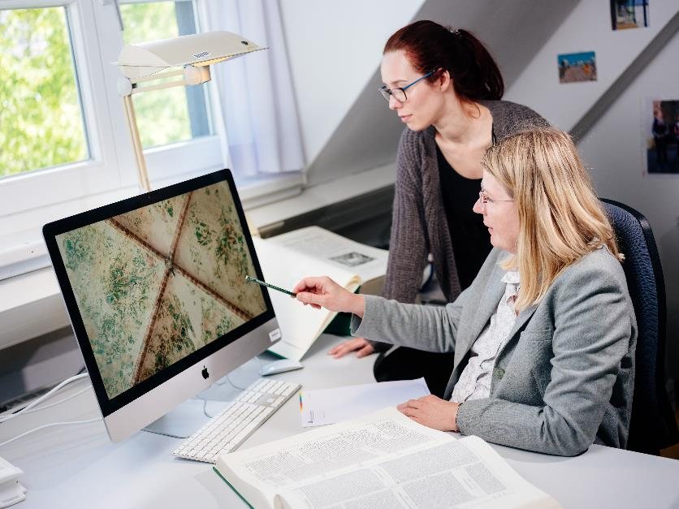
RESEARCH DATA MANAGEMENT
Paderborn University
In Profile
NFDI4Culture

Slide 30
HIGH ACADEMIC AWARDS FOR SCIENTISTS
Paderborn university
In Profile
Leibniz prize winners from Paderborn University
2011: Prof. Dr. rer. nat. Christine Silberhorn (Faculty of Science, Department of Physics)
2002: Prof. Dr.-Ing. Frank Vollertsen (Former Department 10, Mechanical Engineering)
1992: Prof. Dr. math. Friedhelm Meyer auf der Heide (Former Department 17, Computer Science)
1992: Prof. Dr. rer. nat. Burkhard Monien (Former Department 17, Computer Science)

Slide 31
HIGH ACADEMIC AWARDS FOR SCIENTISTS
Paderborn university
In Profile
Award winners of the European Research Council Grants (ERC)
ERC Starting Grant:
2022: Jun.-Prof. Dr. Tim Bartley (Faculty of Science, Department of Physics)
2022: Prof. Dr. Klaus Jöns (Faculty of Science, Department of Physics)
2018: Prof. Dr. Tibor Jager (Faculty of Computer Science, Electrical Engineering and Mathematics, Department of Computer Science)
2016: Prof. Dr. Thomas Kühne (Faculty of Science, Department of Chemistry)
ERC Consolidator Grant:
2016: Prof. Dr. rer. nat. Christine Silberhorn (Faculty of Science, Department of Physics)
2016: ­Prof. Dr. Thomas Zentgraf (Faculty of Science, Department of Physics)
ERC Advanced Grant:
2011: Prof. Dr. Bernhard Krötz (Faculty of Computer Science, Electrical Engineering and
Mathematics, Department of Mathematics)

Slide 32
TRANSFER/FOUNDING

Slide 33
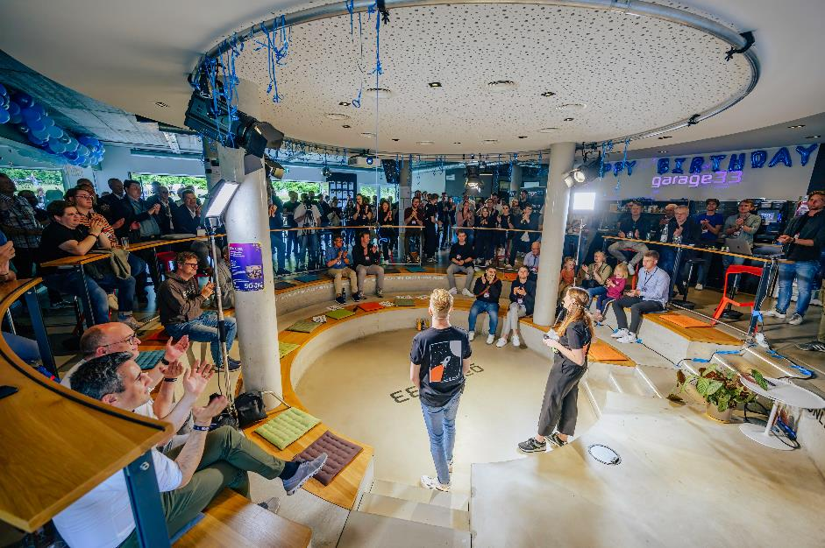
NETWORK
Paderborn University
In Profile
Exzellenz Start-up Center OWL (ESC.OWL) for start-up support

Slide 34
JOINT VENTURES
Paderborn University
In Profile
C-LAB – Cooperative Computing & Communication Laboratory – Joint research and development laboratory operated by Atos and Paderborn University
DMRC – Direct Manufacturing Research Centre – A consortium of industrial partners and Paderborn University
it’s owl – BMBF-Leading-Edge Cluster “Intelligent Technical Systems Ost-Westfalen-Lippe” with 200 partners
L-LAB – Research Centre for Lighting Engineering and Mechatronics. Public Private Partnership between Hella KG Hueck & Co, Hamm-Lippstadt University of Applied Sciences and Paderborn University
SICP – Software Innovation Campus Paderborn – A cooperation of Paderborn University with the Fraunhofer Institute for Mechatronic Systems Design (IEM) and companies of the region

Slide 35
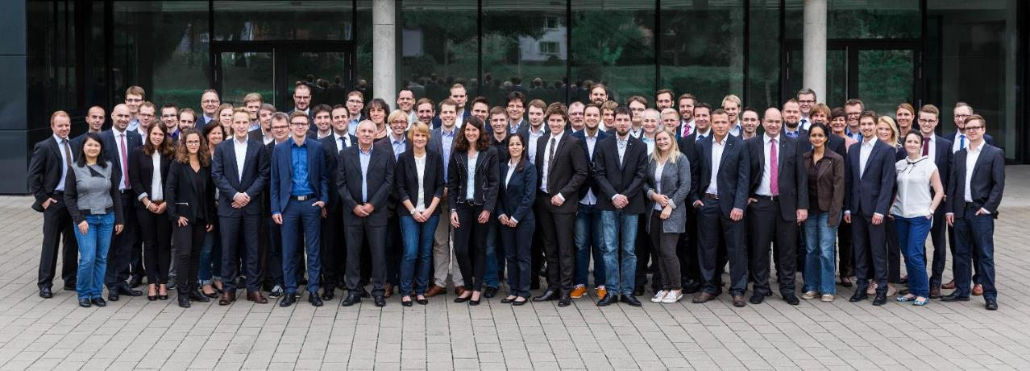
FRAUNHOFER INSTITUTIONS
Paderborn University
In Profile
Fraunhofer ENAS, Department of Advanced Systems Engineering
Fraunhofer Research Institute for Mechatronic Systems Design (IEM)

Slide 36
Paderborn as
a business location

Slide 37
PADERBORN AS A BUSINESS LOCATION
Paderborn University
In Profile
Excellent state-of-the-art research and economic growth characterize the region Ostwestfalen-Lippe (OWL) and make it an established business and science location nationwide.
High-tech research, the promotion of start-ups as well as numerous fruitful collaborations with regional, national and international companies contribute to the status of OWL as one of the strongest economic regions in Germany. As a location for a high number of global players, Paderborn makes an important contribution to this development.
Students and scientists – who are offered the best opportunities for cooperation and careers – also benefit from the network.

Slide 38
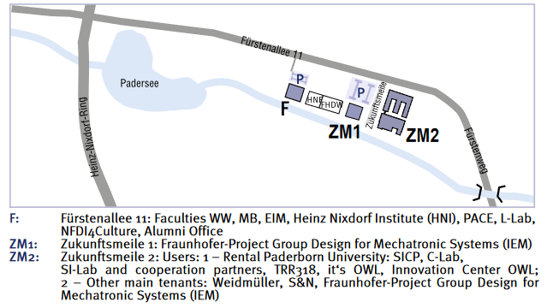
THE UNIVERSITY SITE “ZUKUNFTSMEILE“ AT FÜRSTENALLEE
Paderborn University
In Profile

Slide 39
THE “ZUKUNFTSMEILE“ FÜRSTENALLEE
Paderborn University
In Profile
“Zukunftsmeile 1“
Fraunhofer-Project Group Design for Mechatronic Systems (IEM)
“Zukunftsmeile 2“: users
1 – Rental Paderborn University: SICP, C-Lab, SI-Lab and cooperation partners, TRR318, it‘s OWL, Innovation Center OWL
2 – Other main tenants: Weidmüller, S&N, Fraunhofer-Project Group Design for Mechatronic Systems (IEM)
Building 1

Slide 40
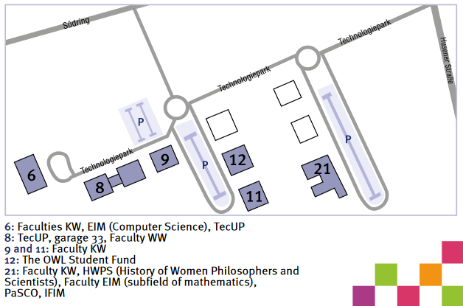
TECHNOLOGY PARK
Paderborn University
In Profile

Slide 41
GARAGE 33
Paderborn University
In profile
Innovation Quarter in the Technology Park
Free space for founders and companies, support for start-ups
Objective: strengthen the start-up ecosystem in the OWL region, particularly Paderborn
Sponsors and partners: Paderborn University, TecUP – Technologietransfer & Existenzgründungs-Center, City of Paderborn, Economic Association “Paderborn überzeugt“ and regional economic partners

Slide 42
SELECTION OF UNIVERSITY SPIN-OFFS (1)
Paderborn University
In Profile
ActiDoo GmbH – Appentwicklung
AMproved GmbH – Lösungen rund um die additive Fertigung
AMENDATE GmbH – Appentwicklung für den 3D-Druck
Assemblean - Produktionsdienstleistungen
ATHENA Technologie Beratung GmbH – Technologieberatung
aXon Gesellschaft für Informationssysteme mbH – Internet-Anwendungen
BEDEM – Personaldienstleister
BotPoint UG – Beratung zum Thema Chatbots
Campus Consult e.V. – Beratung
Campus Consult Projektmanagement GmbH – Projektmanagement
Cargoboard – Logistik
Codeshield – Software
Edelsprint UG – Softwarelösung für die Planung von Scrum-Projekten
energy4ever GmbH – Solartechnik
Enervate – Baubranche
EnVita.one GmbH – Arbeitsmedizische Plattform
Exatrek – Softwarelösungen für Smart farming
ESL EnergieSpeicherLösungen GmbH – Dienstleister für
Elektromobilität
Flocess GmbH – Appentwicklung
GAUSS-LVS GmbH – Software
Heege Software GbR – Digitale Bildverarbeitung
HSM IT-Services GmbH – Oracle Consulting, Apex Entwicklung und Schnittstellendesign
iMPLI Informations-Systeme GmbH – Internetservice
Incony AG – Internetanwendungen
InnovaKom GmbH – Produktdaten- und Bildverwaltung
Intab Pro GbR – Software zur Absatzprognose für das Bäckerhandwerk
ITEK GmbH – Service Forschung, Beratung, Entwicklung & Schulung
JMU GmbH – Chemiebranche
Kaave UG – E-Commerce
KT IT Solutions Oswald & Christ GmbH – IT-Dienstleister
Langlauf Security Automation GmbH – Spitzentechnologie für die automatisierte Software-Security-Analyse

Slide 43
SELECTION OF UNIVERSITY SPIN-OFFS (2)
Paderborn University
In Profile
FASTEC GmbH Materialflussautomation & Produktionsmanagement – Steuerungstechnik
LEONEX Internet GmbH – IT-Dienstleister
maxcluster GmbH – Hosting-Lösungen
mechOnics AG – Linearantriebe Mikro- bzw. Nanopositionierung
MeineLinse GmbH – e-Commerce, Versandhandel
Minplex GmbH – Software
MKV Consult – Marketing
neam IT-Services GmbH – Kommunikationslösungen
nextTalents GmbH – Personaldienstleister u. Projektsupport
OctoGate IT Security Systems GmbH – IT-Sicherheit
onmado UG – Online Marketing Agentur
ORconomy GmbH – Prozessberatung
progresso group GbR – Unternehmensberatung, Prozessoptimierung
Partworks – Ersatzteillösungen für historische Oldtimer
Raynet GmbH – IT-Dienstleister
Reuse And Trade – Online-Business-Marktplatz
Schael Internet-Dienstleistungen – Internet-Dienstleistungen
SICUS GmbH – ITK-Services
Steets – innovative Gesundheitslösungen
SWS SoftWare-Systeme GmbH – Softwarelösungen
Synctive – Software
System Integration Laboratory GmbH – Systemintegrationslösungen
Tarvenkorn & Wickord Patentanwälte Partnerschaftsgesellschaft mbB – Patentanwälte
Teamnet GmbH – Software-Entwicklung
Teburio UG – Tischreservierungssystem
The Spot Ticketing UG – App für digitales Ticketing
Unchained Robotics GmbH – Automatisierungstechnik
Vaira UG – Digitalisierung von Hausanschlussdokumentationen
VanSite – Campingplattform
vermitu GmbH – Vergleichsportal für Medienartikel
W-AYS GmbH & Co. KG – Full-Service-Partner für IT u. Organisation
wabsolute GmbH – Web-Lösungen
ÖZEL Agentur für Design und Marketing GmbH –
Design und Marketing

Slide 44
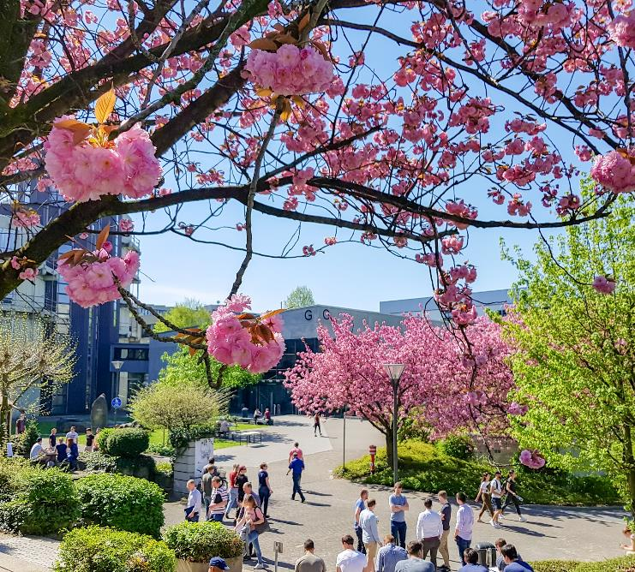
University town
Paderborn

Slide 45
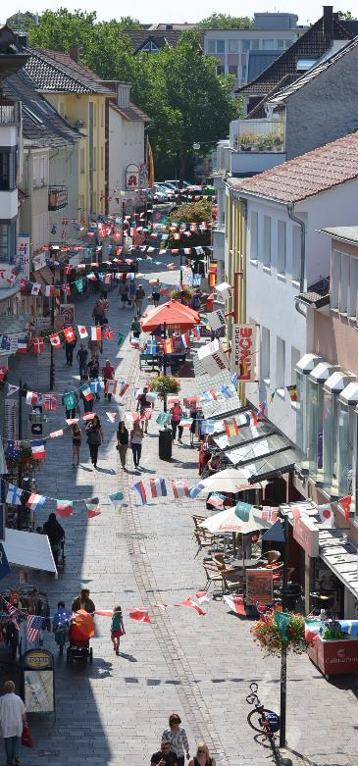
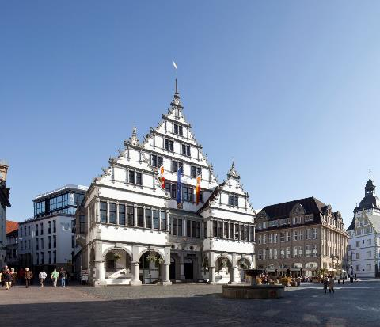
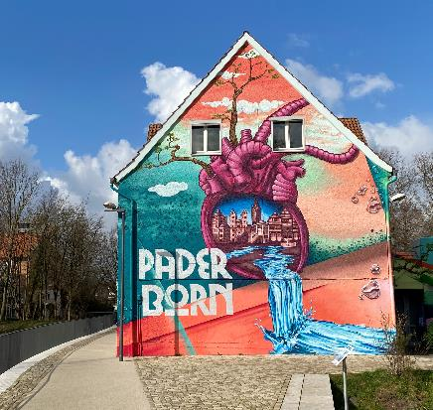
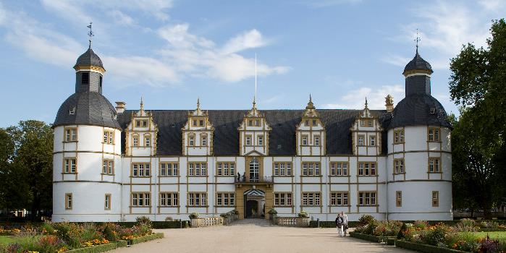
UNIVERSITY TOWN PADERBORN
Paderborn university
In Profile
Photos: City of Paderborn

Slide 46
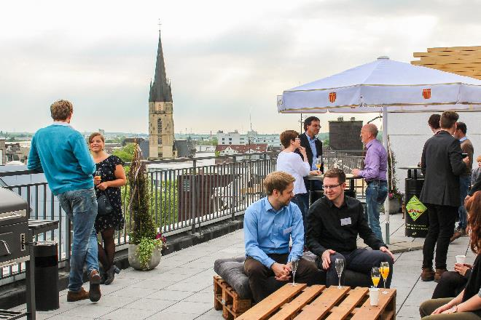
ASTA CITY CAMPUS
Paderborn University
In Profile
The location of the Paderborn students for education, culture, engagement and student sociability at Königsplatz 1.
Event area on the sixth floor, over
600 m², in the heart of Paderborn
Six offices for the student groups of Paderborn University
Area with a large kitchen and a roof terrace for up to 130 persons as well as a seminar room with 20 seats
“Study Space” on the fourth and fifth floor
Learning and writing area: Group and quiet work rooms as well as individual work rooms on over 850 m²

Slide 47
STUDIENFONDS OWL FOUNDATION
Paderborn University
In Profile
Joint foundation established in 2009 by the five universities in OWL – a unique cooperation project in Germany
Financial support for gifted students: awarding of German scholarships, social scholarships and other scholarships
Idealistic support of gifted students, for example through workshops, training courses and scholarship holder-supporters-meetings
Numerous sponsors from the economy, foundations and other institutions
2021/22 donations of almost one million euros raised

Slide 48
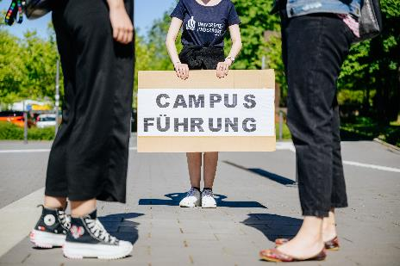
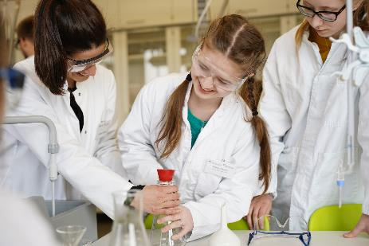
OFFERS FOR PUPILS
Paderborn University
In Profile
Academic Advising Night
Information day for pupils
Insights into the study of physics
“SommerCamp Physik“: physics taster course
“SchülerUni“: Young Students Programme
MINT*-Promotion of young talents
“Frühlings- und Herbstuni“: MINT-taster course for middle and high school students
“look upb“: Schoolgirls-MINT-Mentoring
“coolMINT“ – pupils laboratory; part of the zdi** centre
Further Information: upb.de/studienwahlorientierung
* MINT = Mathematics, Computer Science, Natural Science, Technology
** zdi = Future through innovation

Slide 49
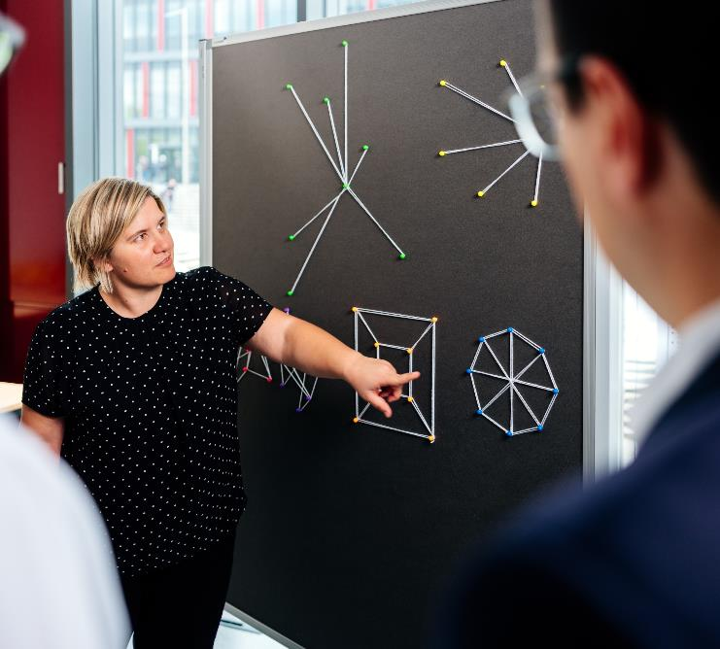
Networks

Slide 50
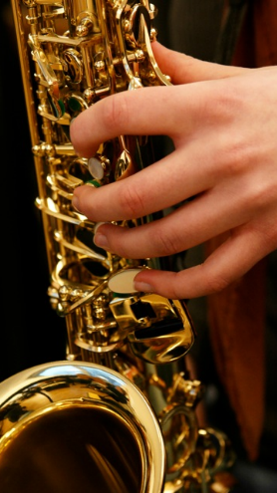
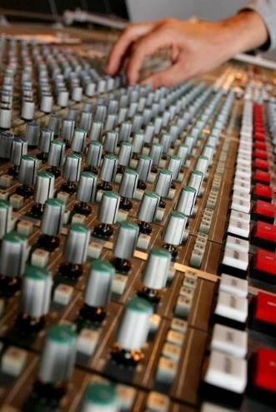
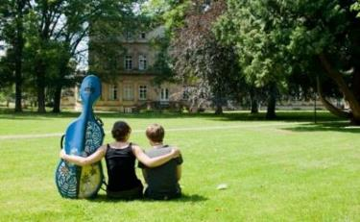
DETMOLD UNIVERSITY OF MUSIC
Paderborn university
In Profile
Musicology Seminar Detmold/Paderborn
Joint institution of Paderborn University and University of Music Detmold
Dedicated to the study and research of music and music culture

Slide 51
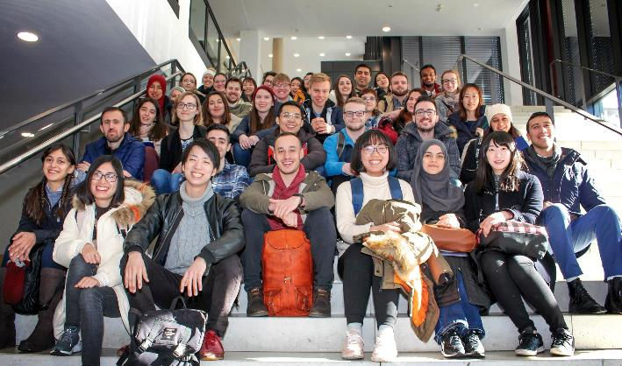
INTERNATIONAL OFFICE
Paderborn University
In Profile
Partnerships with about 215 universities worldwide offer perfect opportunities for exchange programs
12 percent of the students come from abroad
Web: io.uni-paderborn.de

Slide 52
THE UNIVERSITY‘S ALUMNI NETWORKS
Paderborn university
In Profile
Experience UPB and get involved: Networks keep in touch with alumni
Centralised, decentralised and international: the alumni networks are committed to all alumni who have fond memories of their time at the university, would like to stay up to date with campus life and get involved with the students and UPB.
Former students, professors and employees of the faculties, institutes, departments and facilities are active in the networks. Further information: upb.de/alumni
Aims:
🎓 promote solidarity and identification with UPB
🎓 passing on alumni knowledge to students
🎓 winning partners in practice and science

Slide 53
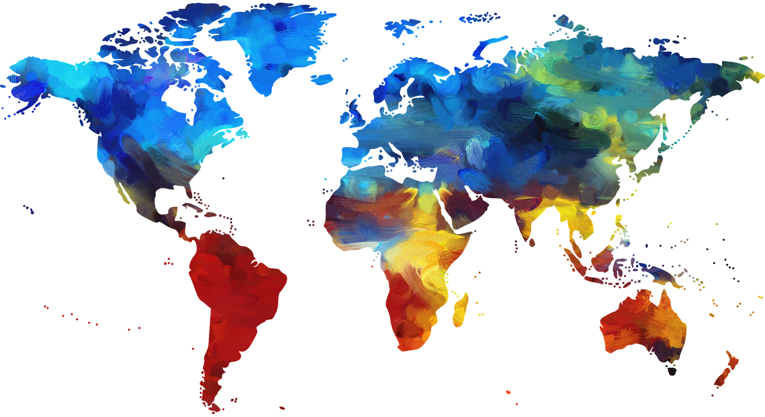
INTERNATIONAL RELATIONS OFFICE
Paderborn university
In Profile
Strategic development and expansion of international relations
Organisation and implementation of central international projects
Welcome Services for the practical support of international researchers and international employees
Development and expansion of international alumni work
Communication of central internationalisation measures
Further information: upb.de/en/international-relations

Slide 54
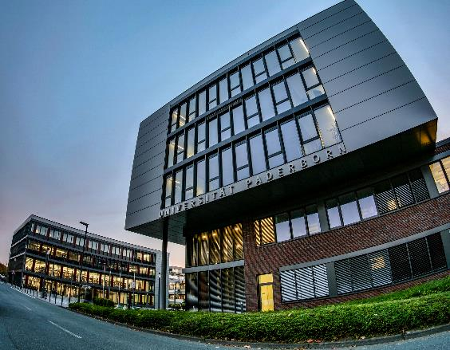
WELCOME SERVICE FOR INTERNATIONAL RESEARCHERS AND EMPLOYEES
Paderborn university
In Profile
Paderborn University‘s Welcome Service supports international researchers and employees before, during and after their stay in Paderborn
Advice and support for international researchers and employees
Administrative support for hosts
Website which provides detailed information about working and living in Paderborn
Events and networking opportunities
Newsletter
Further information: upb.de/welcome-service

Slide 55
CAMPUS OWL
Paderborn university
In Profile
Network of ﬁve higher education institutions in Ostwestfalen-Lippe (OWL) with a liaison office in New York
Campus OWL
Founded in early 2016 by the Universities of Bielefeld and Paderborn, the University of Applied Sciences Bielefeld, the University of Applied Sciences Ostwestfalen-Lippe and the University of Music Detmold
Provides a framework for cooperation projects
Increases the visibility of the science region Ostwestfalen-Lippe, especially in the areas of research, transfer, internationalisation and digitalisation
Liaison office in New York
Promotes study and research opportunities
Promotes cooperation with North American partner institutions
Service facility and contact point for students, scientists, founders and administrative staff from the universities in OWL and North America
Further Information: www.campus-owl.org/

Slide 56
Impressions
OF the campus

Slide 57
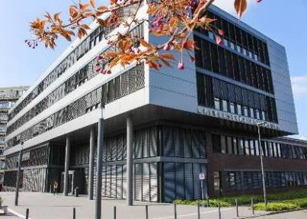
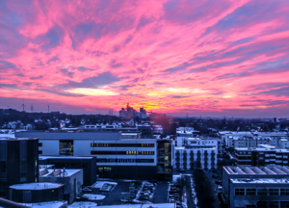
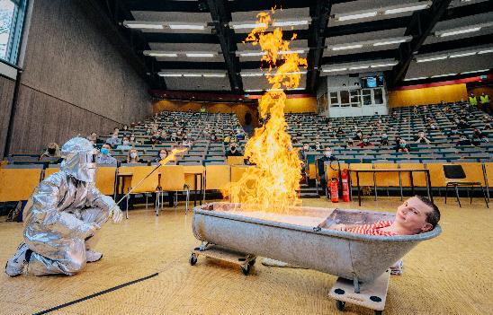
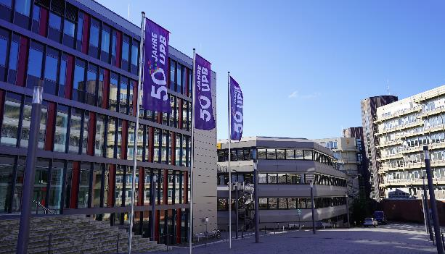
IMPRESSIONS
Paderborn university
In Profile

Slide 58
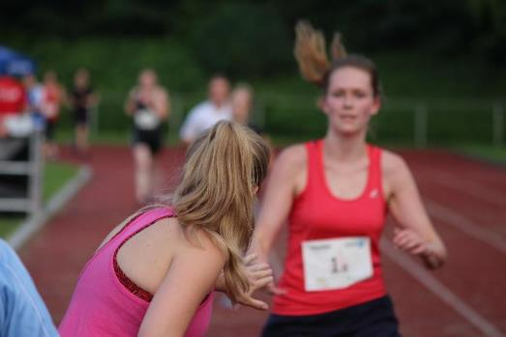
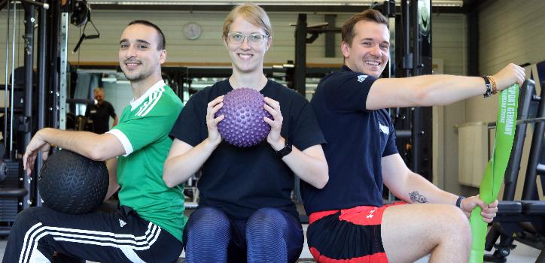
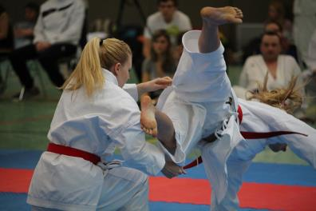
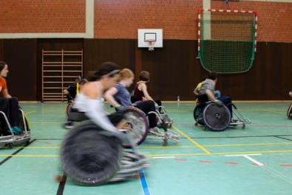
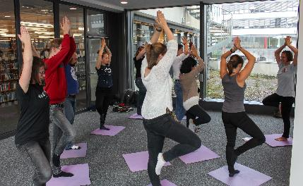
UNIVERSITY SPORTS AND HEALTHY UNIVERSITY
Paderborn university
In Profile

Slide 59
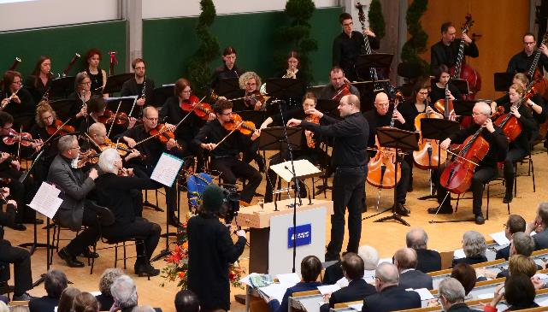
CULTURAL ACTIVITIES ON THE CAMPUS
Paderborn university
In Profile

Slide 60
GASTRONOMIC FACILITIES
Paderborn university
In Profile

Slide 61
ASTA SUMMER-FESTIVAL
Paderborn university
In Profile

Slide 62
IMPRINT
Paderborn University
In profile
Published by: Paderborn University
Editorial responsibility: Department Press, Communications and Marketing
July 2022

